Slide 1
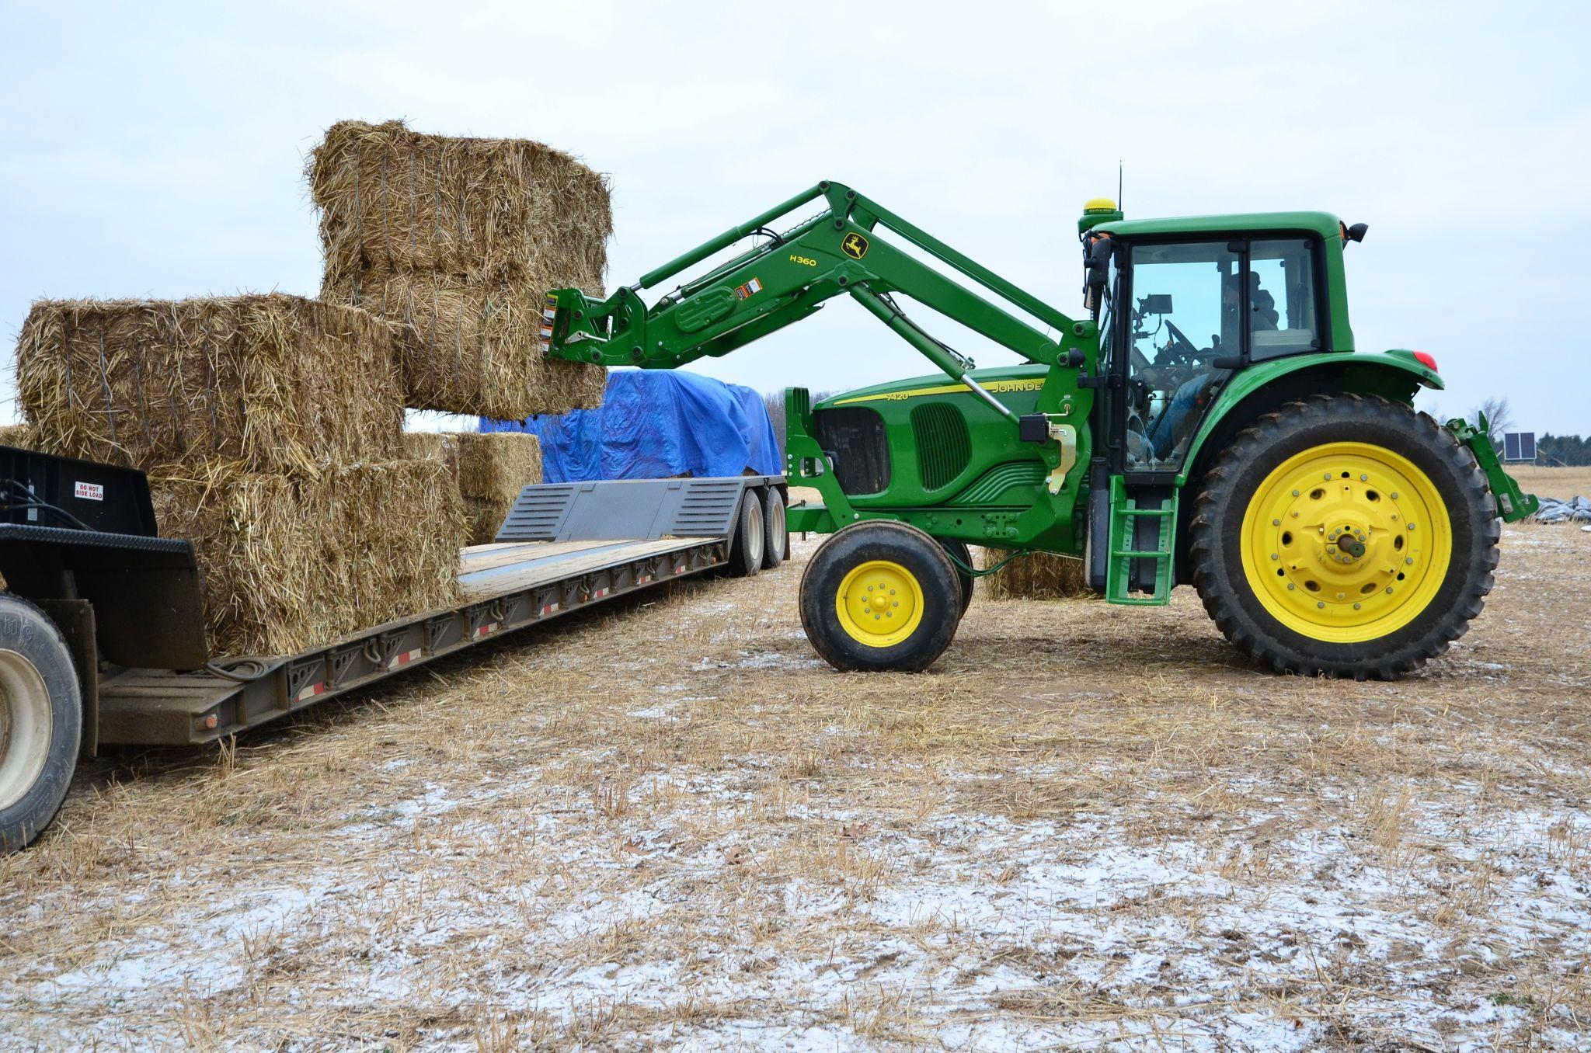
Assessing impacts of supply chain variability on centralized cellulosic biorefinery
Background/Objective
Cellulosic biofuels derived from crop residues and dedicated energy crops grown on marginal lands are an attractive alternative to liquid fossil fuels. This study seeks to show how annual fluctuations in biomass production impact the economic and environmental performance of biofuels.
Approach
Researchers employ various modeling approaches, including deterministic and stochastic methods, to analyze the biofuel supply chain and evaluate economic, environmental, and social impacts. The study compares a reference scenario that assumes constant biomass supply with scenarios that account for annual variations in production. Dynamic life cycle assessment (LCA) calculations, including dynamic GHG emission factors and time-dependent global warming potentials, are used to estimate the global warming impact in these scenarios.
Loading switchgrass bales
Results
Year-to-year fluctuations in cellulosic biomass production influence centralized biorefinery operations that rely on bale-format biomass within a short collection radius. When supply is insufficient, biofuel production decreases while operating costs remain relatively constant, leading to higher per-unit costs. Conversely, excess supply results in additional storage costs. Biomass pellets can serve as an auxiliary feedstock to minimize the impacts of supply chain volatility. A carbon tax credit applied to soil organic carbon sequestration reduces the gap between economic and environmental performance.
Significance/Impacts
Previous analyses have overlooked the variability of biomass supply. This more nuanced understanding of the cellulosic biofuel supply chain can help optimize biorefinery operations, improve economic performance, and maximize the environmental benefits of these alternative fuels.
Kim, Seungdo, et al., Supply chain system for a centralized biorefinery system based on switchgrass grown on marginal land in Michigan. Biofuels, Bioproducts and Biorefining, 17, 1502–1514. (2023) [DOI:10.1002/bbb.2526]

