Slide 1

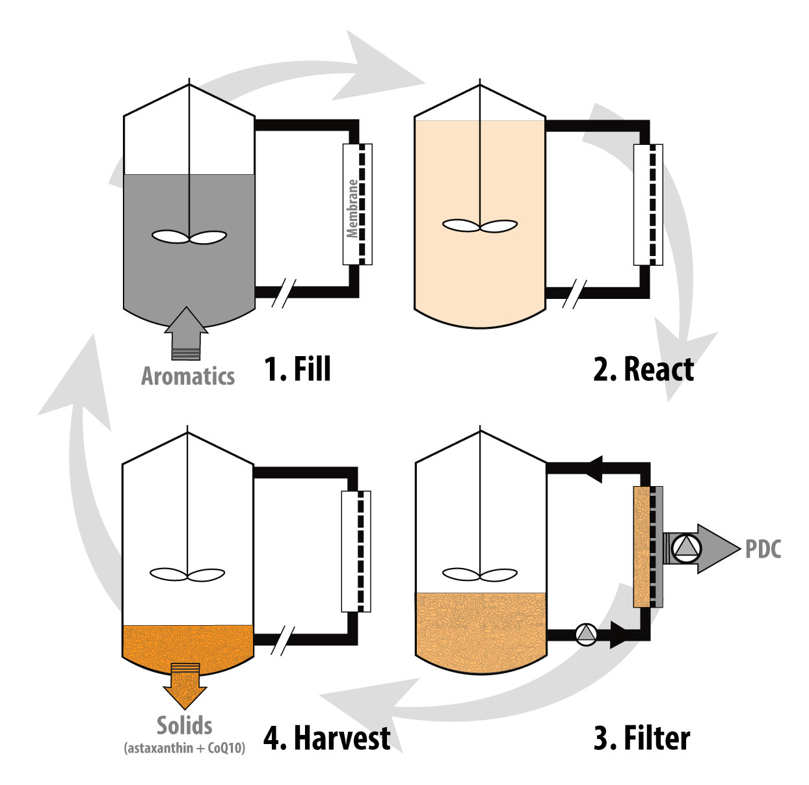
Step-feeding reactor maximizes concurrent production of intracellular and extracellular products from poplar biomass
Background/Objective
High biochemical production through biotransformation of renewable resources into platform chemicals requires concentrated cultures that generate abundant cell biomass in addition to the product of interest. This work investigated bioreactor processes for high productivity of intracellular and extracellular products to valorize cell biomass.
Approach
Researchers evaluated a previously described membrane bioreactor (MBR) system using a strain of Novosphingobium aromaticivorans engineered to extracellularly produce 2-pyrone-4,6-dicarboxylic acid (PDC) and intracellularly accumulate astaxanthin and coenzyme Q₁₀ (CoQ₁₀) from aromatic substrates derived from plant biomass.
Results
A continuously fed MBR maximized extracellular production but had a negative effect on intracellular product accumulation. Operating the MBR as a step-fed sequencing batch reactor (SBR) resulted in stable concurrent production. Using poplar alkaline pretreatment liquors, the SBR-MBR system with step-feed operation achieved productivities of 1.14 g PDC/L-hr as the extracellular product and 0.043 mg astaxanthin/L-hr and 0.64 mg CoQ₁₀/L-hr as intracellular products.
Schematic of the SBR-MBR system cycle
Significance/Impacts
This study demonstrated that it is possible to establish bioreactor operating conditions for stable production of extracellular and intracellular products by N. aromaticivorans, potentially valorizing large amounts of cell biomass generated during biotransformation.
Kim, B., et al. Using Novosphingobium aromaticivorans for Concurrent Production of Intracellular and Extracellular Products from Aromatics Extracted from Poplar Biomass. ACS ES&T Engineering. (2026). [DOI:10.1021/acsestengg.5c00956]

