Slide 1
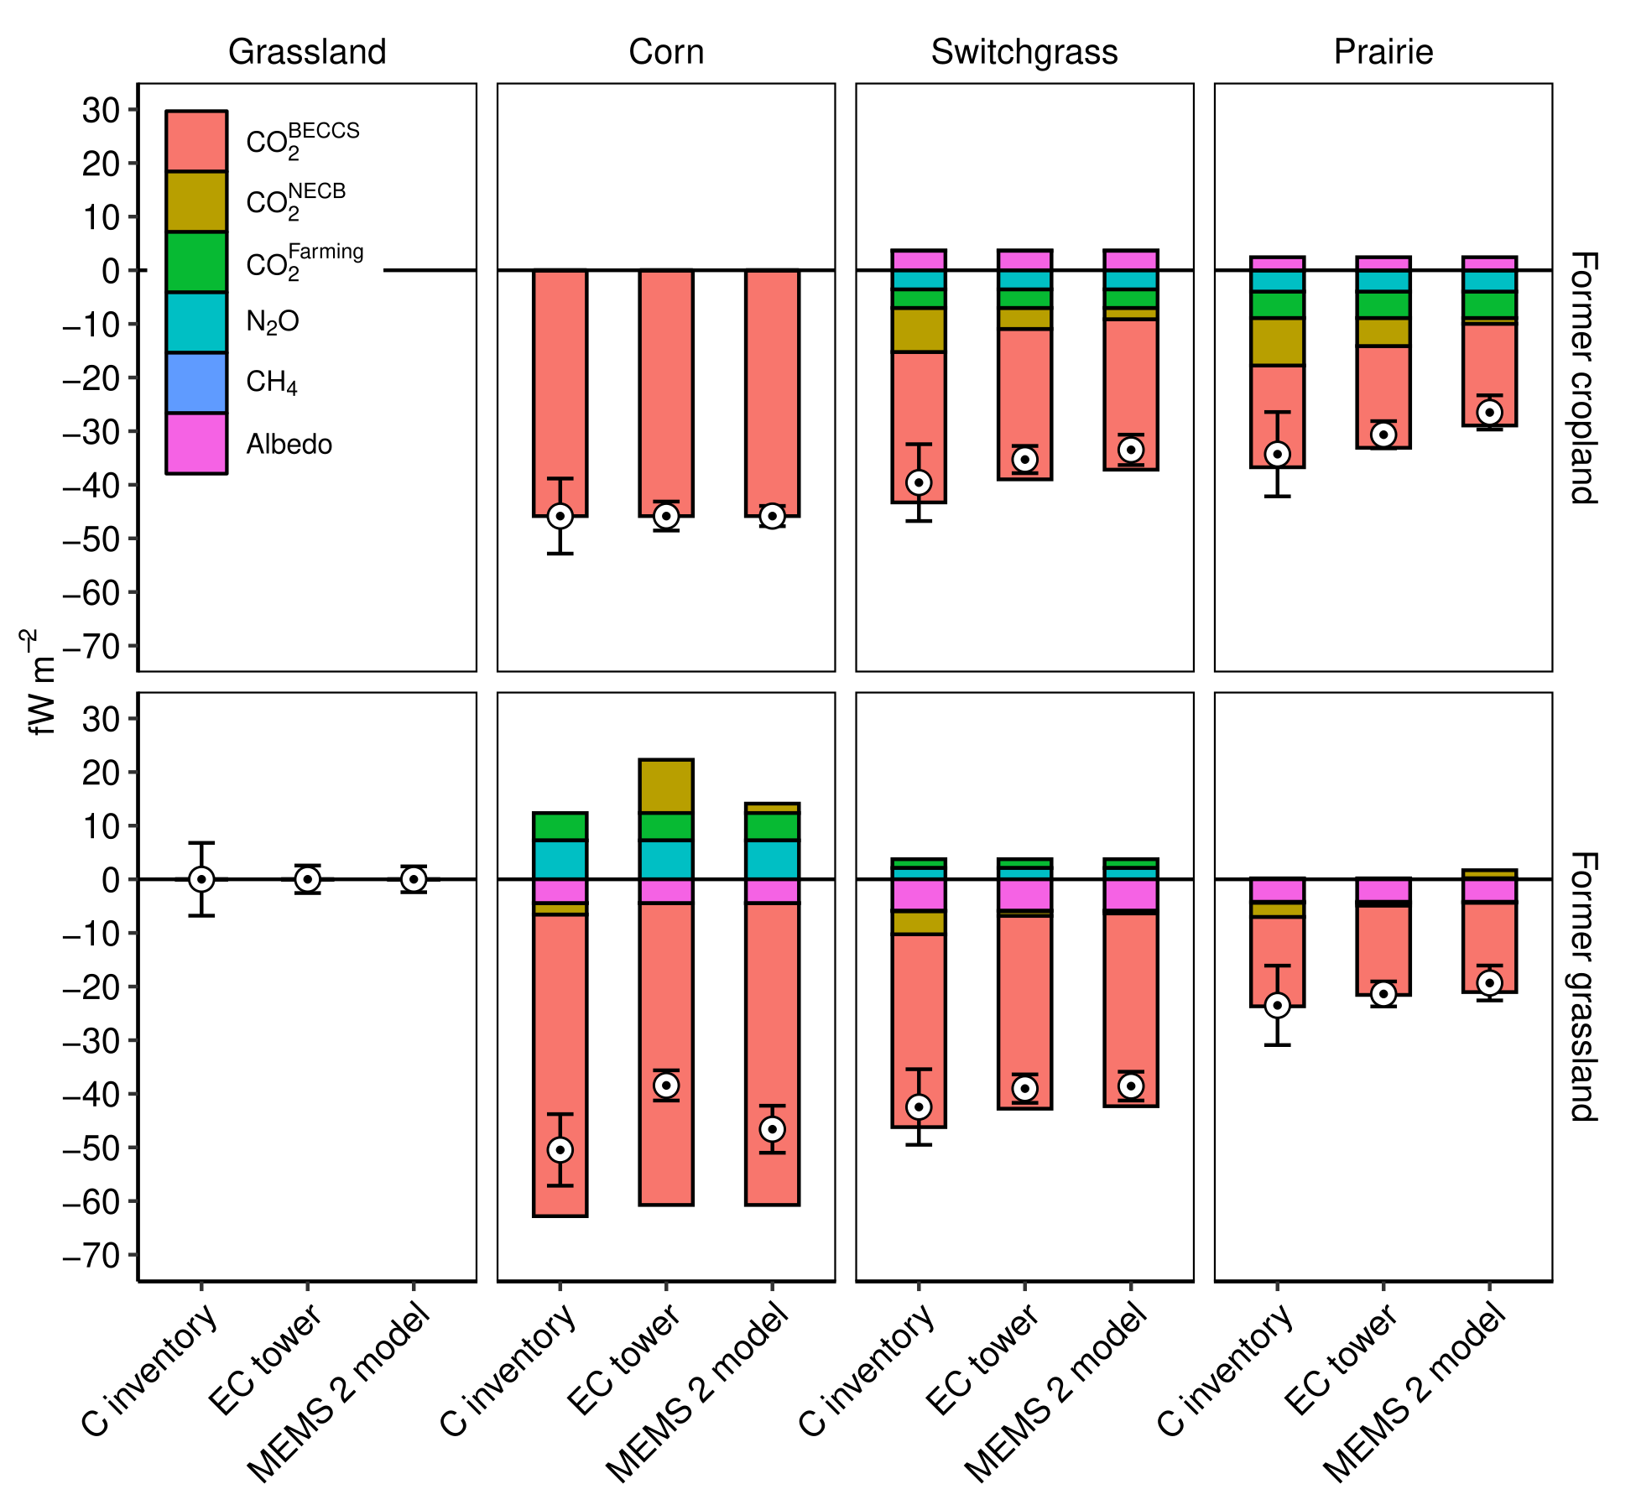
Combining methods increases confidence when estimating climate impact of bioenergy crops
Background/Objective
Bioenergy with carbon capture and storage (BECCS) may be necessary to limit the rise in global temperatures but requires vast amounts of land, and the change in land use could have positive or negative impacts on the climate. This work examines three methods for estimating the impacts and shows how some scenarios can reduce warming.
Approach
Researchers used eddy covariance towers, soil and plant carbon inventories, and the MEMS 2 process-based ecosystem model to evaluate the associated radiative forcings from changes to ecosystem carbon stocks, soil nitrous oxide and methane fluxes, albedo, embedded fossil fuel use, and geologically stored carbon associated with three bioenergy crops (corn, switchgrass, and mixed prairie) on former grassland and former cropland.
Results
All methods agree that establishing perennials (switchgrass or prairie) on former cropland results in net negative radiative forcing of -26.5 to -39.6 fW m⁻² over 100 years. Perennials on former grassland provide similar cooling effects of -19.3 to -42.5 fW m⁻². Establishing corn for BECCS on either landscape provides the greatest climate mitigation (-38.4 to -50.5 fW m⁻²), as higher plant productivity results in more geologically stored carbon. Geologic storage of biomass carbon was, on average, the largest component of the radiative forcing budget, followed by on-site net ecosystem carbon balance, albedo, nitrous oxide, embedded fossil fuels, and methane.
Average instantaneous radiative forcing for each component and method during the 100-year period following the land use change event.
Significance/Impacts
The study highlights the strengths and limitations of each method for quantifying field-scale climate impacts of BECCS and show that using multiple methods increases confidence in radiative forcing estimates.
Falvo, G., et al. Combining Eddy Covariance Towers, Field Measurements, and the MEMS 2 Ecosystem Model Improves Confidence in the Climate Impacts of Bioenergy With Carbon Capture and Storage. GCB Bioenergy, 17, e70023. (2025). [DOI:10.1111/gcbb.70023]

