Slide 1
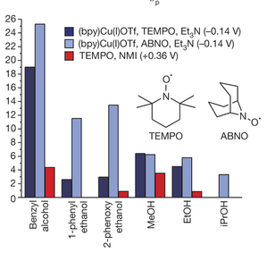
BRC Science Highlight
Cooperative electrocatalytic alcohol oxidation with electron-proton transfer mediators
Objective
Developing electrocatalysts for alcohol oxidation that operate at low electrode potentials.
Approach
Copper/organic nitroxyl co-catalysts were previously used for selective oxidation of alcohols with O₂; special selectivity reflects catalysts’ unique mechanism of action.
Here, Cu/nitroxyl co-catalysts are shown to be very effective electrocatalysts, exhibiting low-overpotential and high activity for the oxidation of diverse alcohols.
Result/Impacts
Catalyst system presented consists of two different components : TEMPO and a molecular Cu-complex.
Fig. A. Relative catalytic activity of three different catalyst systems with various alcohols.
Figure A shows the (bpy)Cu/nitroxyl catalysts exhibited substantially higher rates than the TEMPO-only catalyst for all substrates tested, including excellent reactivity with methanol and ethanol.
By working with a first-row transition metal (such as bpy(Cu)), electron-proton transfer mediators provide the basis for efficient proton-coupled 2-electron reactivity, and it can lead to much faster electrocatalytic rates and lower overpotentials, both of which are crucial in energy-conversion applications.
Badalyan A, Stahl SS. “Cooperative electrocatalytic alcohol oxidation with electron-proton-transfer mediators.” Nature (2016) [DOI: 10.1038/nature18008]
GLBRC October 2016
Notes:
Notes:
text
Title again:
Text 1-2 sentence summary?

