Slide 1
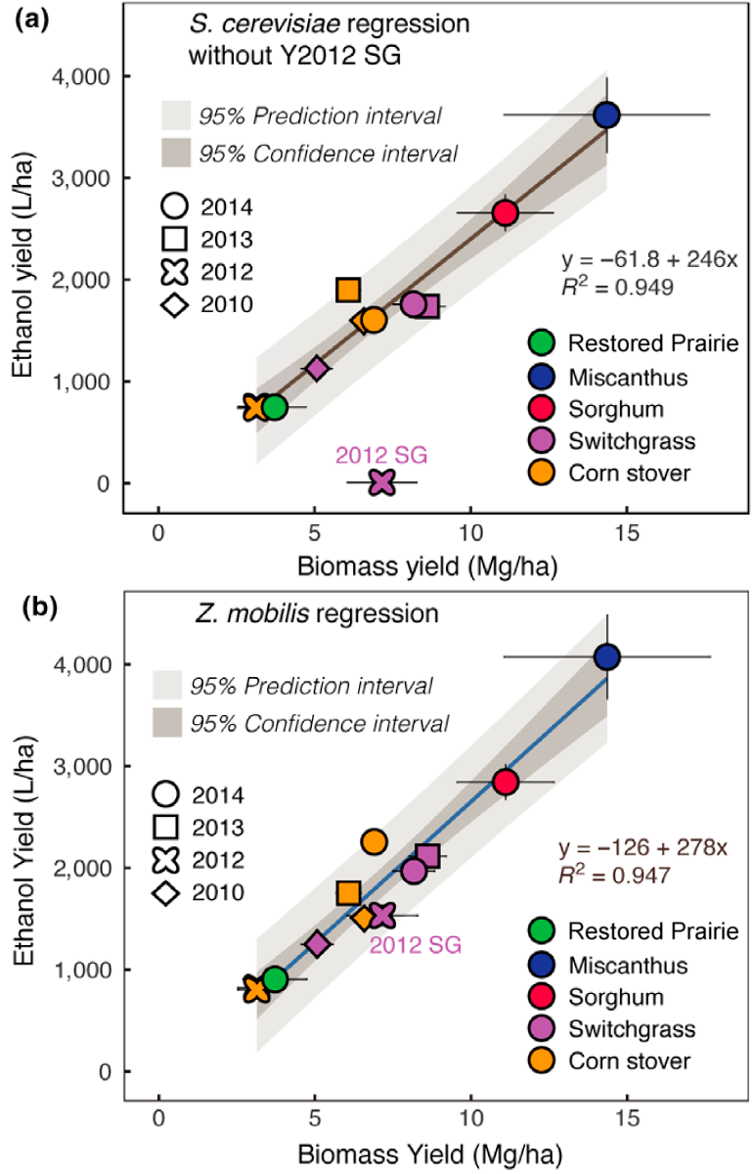
BRC Science Highlight
Process and field-scale ethanol yields of five lignocellulosic feedstocks
Objective
In this study, GLBRC scientists investigated how five different feedstocks affected process ethanol yield (efficiency of microbes during fermentation) and field-scale ethanol yield (ethanol production per land area) to determine if lignocellulosic biorefineries can accept and process a variety of feedstocks.
Approach
Two annual (corn stover and energy sorghum) and three perennial (switchgrass, miscanthus, and restored prairie) feedstocks were grown, harvested, pretreated with ammonia fiber expansion (AFEX), and hydrolyzed.
Hydrolysate was fermented separately using yeast (Saccharomyces cerevisiae Y128) or bacteria (Zymomonas mobilis 8b).
Result/Impacts
Most feedstocks showed similar process ethanol yields, especially when Z. mobilis was used.
Both biomass quality (chemical composition, moisture, etc.) and biomass yield affected field-scale ethanol yield.
Experimentally-determined ethanol yields per hectare correlate with biomass yield.
Biomass quality was the main driver for the ethanol yields for high-yielding crops and biomass yield was the main driver for the ethanol yields for low‐productivity crops.
To increase ethanol yield in high-yielding crops, focus should be on improving biomass quality or conversion efficiency, whereas for low-yielding crops, focus should be on increasing crop yield.
Results suggest that lignocellulosic biorefineries should be able to accept a wide range of feedstock types, which may improve the environmental footprint of the facility; biorefinery economics; and harvest, storage, and transportation logistics.
Zhang, Y., et al. “Diverse lignocellulosic feedstocks can achieve high field-scale ethanol yields while providing flexibility for the biorefinery and landscape-level environmental benefits.” GCB Bioenergy 2018, DOI: 10.1111/gcbb.12533
GLBRC July 2018
Notes:
Notes:
text
Title again:
Text 1-2 sentence summary?

