Slide 1
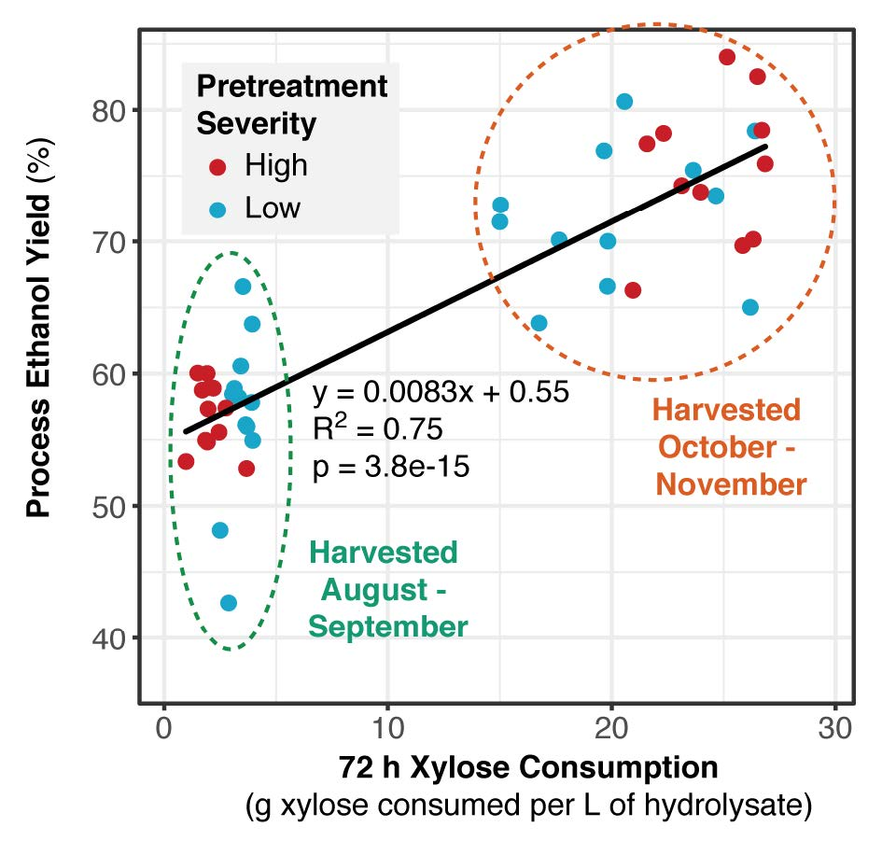
BRC Science Highlight
Switchgrass Harvest Date Affects Xylose Utilization and Ethanol Yield
Objective
In this work, GLBRC scientists investigated if switchgrass harvest could be timed to result in the most beneficial impacts on fermentation.
Approach
Switchgrass was harvested every 2-3 weeks from peak biomass (late Aug.) to killing frost (early Nov.), for three pre- and three-post senescence harvest dates.
Samples were subjected to AFEX pretreatment and enzymatic hydrolysis, then fermented using Saccharomyces cerevisiae 424A.
Xylose consumption is correlated to process ethanol yields, which tend to be lower for harvest dates before October and show a similar trend regardless of pretreatment condition.
Result/Impacts
The three pre-senescence harvest dates resulted in poor xylose consumption, and therefore, low ethanol yields. In the three post-senescence harvest dates, xylose was almost fully consumed and ethanol yields were higher.
Harvest should be delayed until switchgrass begins to enter dormancy, but it may not be necessary to wait until after a killing frost.
Ong, R. G., et al. “Pre-senescence harvest of switchgrass inhibits xylose utilization by engineered yeast.” Frontiers in Energy Research 6, 52 (2018), DOI:10.3389/fenrg.2018.00052.
GLBRC July 2018
Notes:
Notes:
text
Title again:
Text 1-2 sentence summary?

