Slide 1
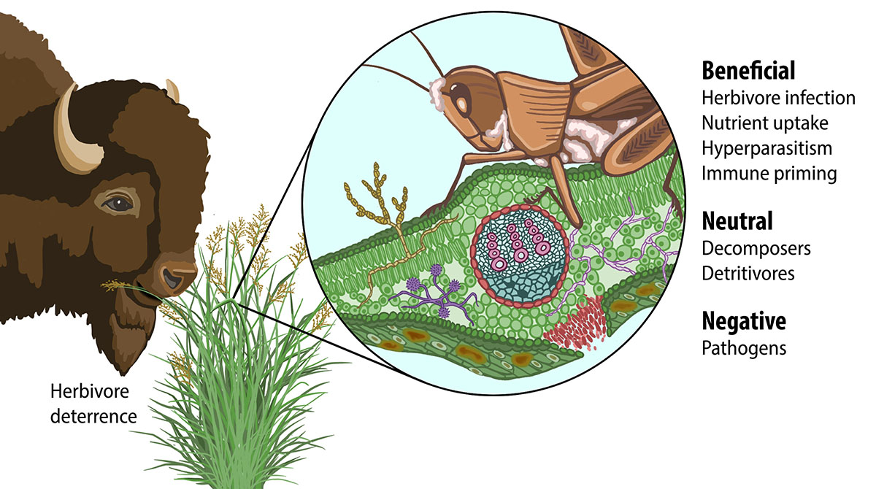
Plant genetics impact above ground microbiome in bioenergy crops
Background/Objective
Explore whether differences in switchgrass genes across subpopulations influence its leaf microbiome in varied geographical locations.
Approach
Observe changes in the fungal microbiome on the surface of randomly selected switchgrass populations over the course of a season.
Link variations in the fungal community over time with similarities subpopulations of switchgrass.
Identify associations between genetic expression in the plants and changes in the fungal community.
Results
Three gene locations in switchgrass subvarieties were found that demonstrated a role in controlling fungal communities on the plants.
Plant leaves contain an ecosystem of microbes that can help or hurt their host. This study examines changes to the essential fungi that might live on the leaves of bioenergy crops.
Switchgrass may control the seasonal development of their leaf microbiome indirectly through a few immune-related genes, indicating that the focal immune genes may impact the whole microbiome by controlling just a few key pathogens.
Understanding how the plant controls its microbiome can help breeders produce varieties that are better at recruiting beneficial microbes.
Knowing more about natural seasonal patterns in leaf microbes can help growers time management interventions such as fungicide.
VanWallendael, A., Benucci, G.M.N., da Costa, P.B., Fraser, L., Sreedasyam, A., Fritschi, F., Juenger, T. E., Lovell, J.T., Bonito, G. Lowry, D.B., “Host genotype controls ecological change in the leaf fungal microbiome.” PLOS Biology 20 (8): e3001681 (2022) [DOI: 10.1371/journal.pbio.3001681]

