Slide 1
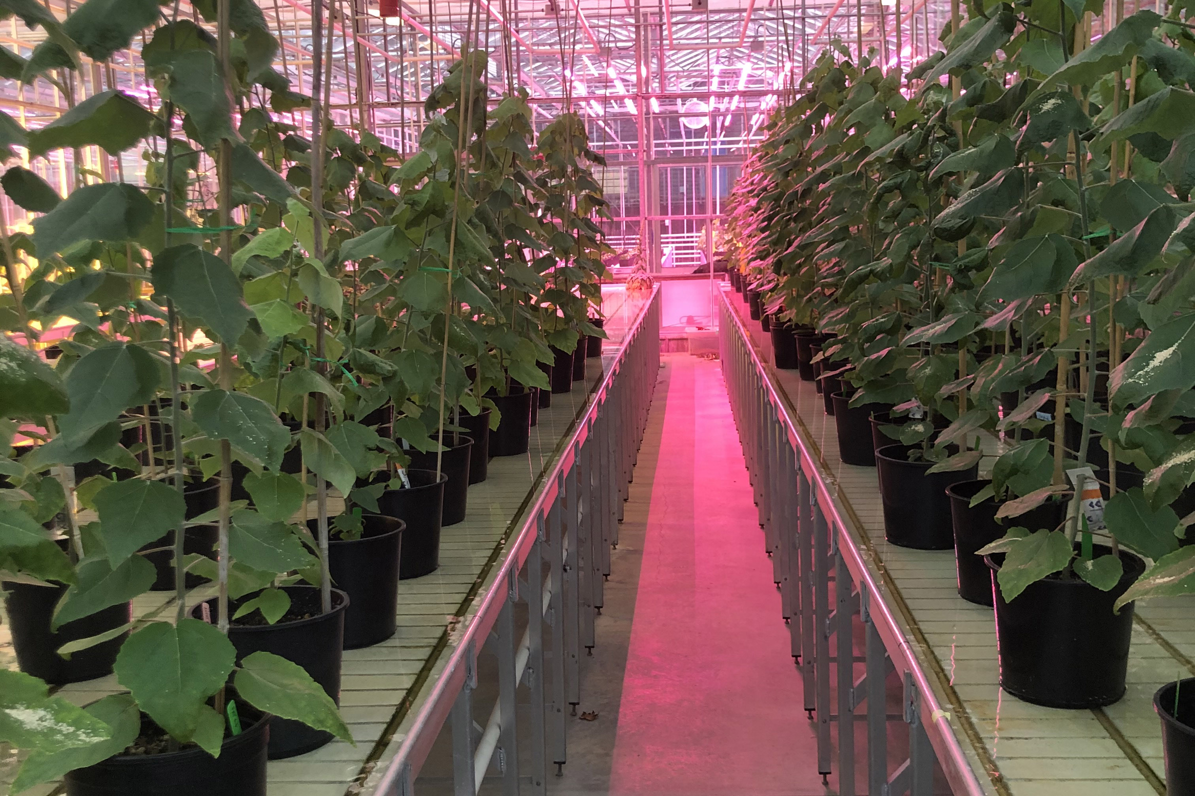
Modified poplar with altered lignin composition is more valuable and easier to break down
Background/Objective
Harness the flexibility of the lignin biosynthesis pathway to engineer bioenergy crops that are more valuable and less expensive to break down.
Approach
Transform a hybrid poplar with 3-dehydroshikimate dehydratase gene (QsuB), which has shown the potential to divert carbon away from the lignin biosynthesis pathway and toward soluble dihydroxybenzoate (DHB), a platform chemical and precursor to high-value products like plastics.
Results
Transgenic poplar wood had up to 33% less lignin, and an improved saccharification, releasing up to 40% more glucose.
Poplars also revealed novel incorporation of DHB into the backbone of lignin, introducing weaker bonds, or ‘zips’, to the polymers.
Genetically engineered poplars showed changes in lignin composition for easier deconstruction and greater sugar yield. Image courtesy of Faride Unda.
Significance/Impacts
This work demonstrates how engineering bioenergy crops can not only improve the efficiency of industrial biomass deconstruction by adding cleavable ‘zip-lignin’ but also increase the value of the biomass, as soluble DHB could be a valuable coproduct in future biorefineries.
Unda, F., Mottiar, Y., Mahon, E.L., Karlen, S.D., Kim, K.H., Loqué, D., Eudes, A., Ralph, J. and Mansfield, S.D., “A new approach to zip-lignin: 3,4-dihydroxybenzoate is compatible with lignification.” New Phytologist, 235: 234-246 (2022) [DOI: 10.1111/nph.18136]

