Slide 1
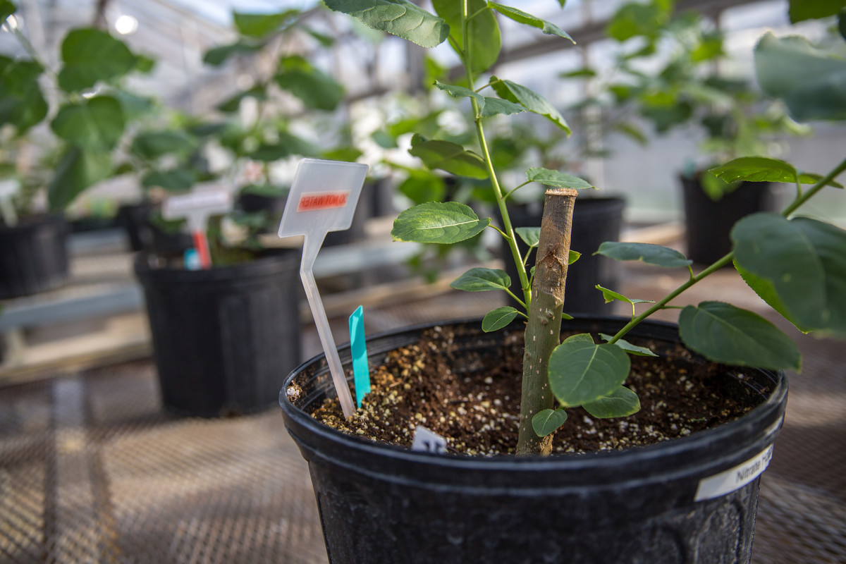
Engineered poplar lignin has more of valuable “clip-off” chemical
Background/Objective
Up to 10% of poplar lignin is naturally comprised of p-hydroxybenzoates (pHBs), a valuable, easy to “clip-off”, chemical
This study explore explores how flexibility of lignin synthesis can be harnessed to produce biomass with more of these valuable chemicals.
Approach
Transform hybrid poplar lines with bacterial chorismite pyruvate lyase (CPL), which in plants has shown to produce more pHBs.
Results
Poplars expressing bacterial CPL produced lignin with 50% more stable pHBs
Developing trees had 10 times more pHBs compared to control trees.
Engineering bioenergy crops, like these poplar trees, can produce biomass with lignin that is more valuable and/or easier to break down.
Significance/Impacts
This work demonstrates how engineering bioenergy crops can improve the efficiency and value of industrial biomass deconstruction by increasing the amount of easily cleavable and valuable chemical groups.
Mottiar, Y., Karlen, S.D., Goacher, R.E., Ralph, J. and Mansfield, S.D., “Metabolic engineering of p-hydroxybenzoate in poplar lignin.” Plant Biotechnology Journal. (2022) [DOI: 10.1111/pbi.13935]

