Slide 1
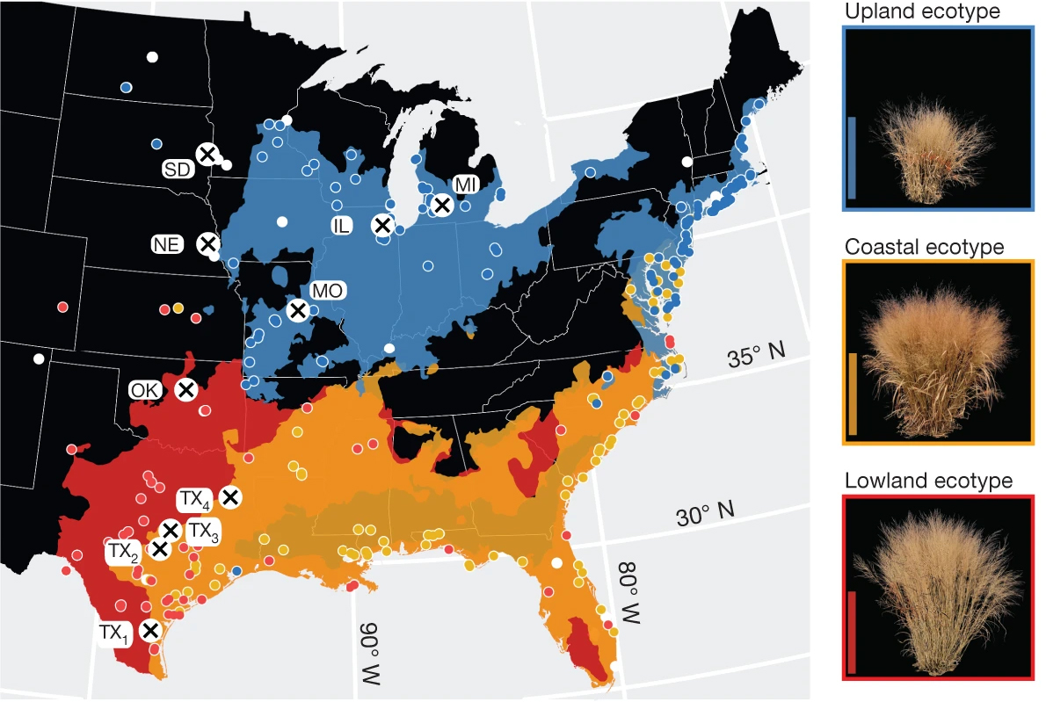
BRC Science Highlight
Nationwide collaboration unlocks switchgrass genome
Objective Produce a high-quality reference sequence of the complex switchgrass genome
Approach
Set up 10 common gardens spanning climate zones across eight states and 1,100 miles, each containing a propagated panel of 732 switchgrass genotypes.
Sequence, assemble, and annotate the switchgrass genome.
Analyze biomass and survival among genotypes for climate–gene–biomass associations.
Result/Impacts
The reference genome will provide breeders with the necessary tools to increase switchgrass yield for the sustainable production of bioenergy.
Geographic distribution of common gardens and plant collection locations, and spatial distribution models of each ecotype. The ecotype color legend accompanies the representative images of each ecotype to the right of the map.
All four BRCs have expanded the network of common gardens and are exploring improvements to switchgrass through more targeted genome editing techniques to improve crop traits and customize the crop for additional end products.
Lovell, J.T., et al. “Genomic mechanisms of climate adaptation in polyploid bioenergy switchgrass,” Nature (2021). [DOI: 10.1038/s41586-020-03127-1]
GLBRC February 2021
Department of Energy • Office of Science • Biological and Environmental Research
Notes:
Notes:
text
Title again:
Text 1-2 sentence summary?

