Slide 1
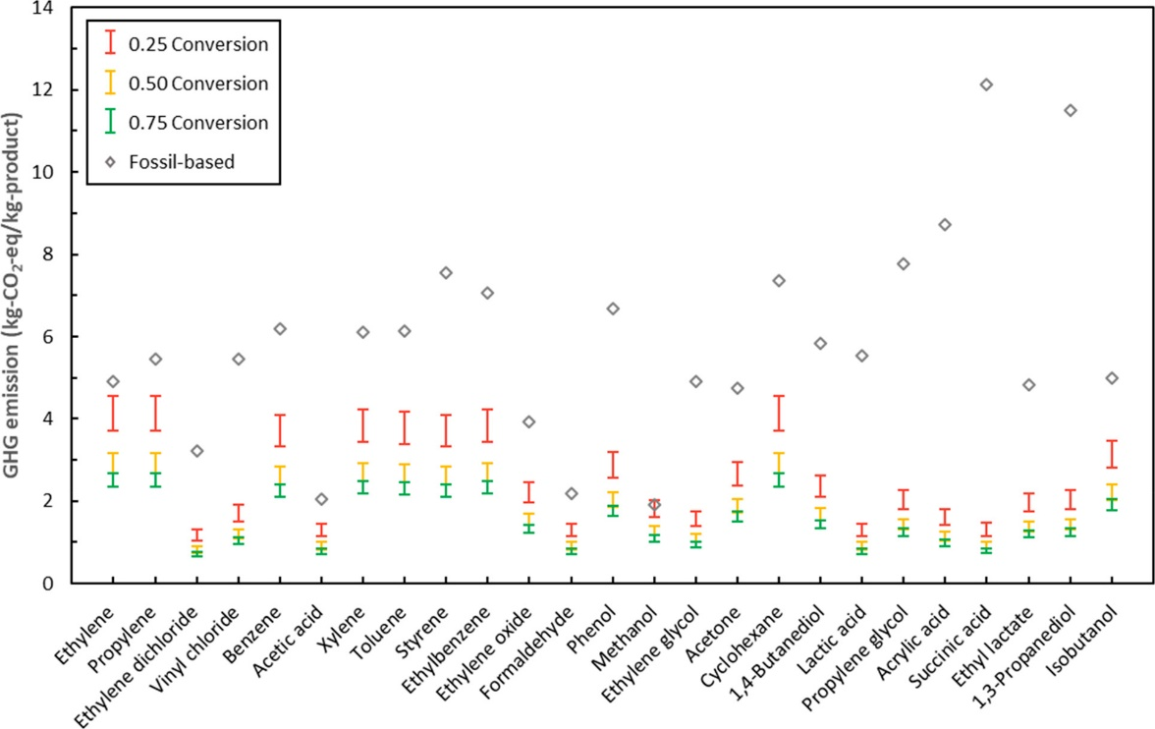
Greenhouse gas emission mitigation potential of chemicals produced from biomass
Background/Objective
Compare greenhouse gas (GHG) emissions for industrial production of 25 industrially-relevant chemicals in a model biorefinery to that of a typical oil refinery.
Approach
Model biorefinery production of 25 chemicals at three levels of conversion efficiency, 25%, 50%, and 75%.
Compare estimated GHG emissions of biorefinery production to known oil-based GHG emissions for these chemicals.
Results
Production of these chemicals in a biorefinery was estimated to reduce emissions between 88% and 94% compared to known GHG emissions from oil-based production.
Producing common industrial chemicals in a biorefinery could reduce greenhouse gas emissions by up to 94% compared to a traditional oil refinery.
Significance/Impacts
The study discusses how biomass supply, molecular characteristics, separation efficiency, and conversion rates impact GHG mitigation potential.
The study presents a roadmap for choosing biochemicals to produce in future biorefineries.
Huang, K., Peng, X., Kong, L., Wu, W., Chen, Y., and Maravelias, CT. “Greenhouse gas emission mitigation potential of chemicals produced from biomass.” ACS Sustainable Chem. Eng., 9, 43, 14480–14487 (2021) [DOI: 10.1021/acssuschemeng.1c04836]

