Slide 1
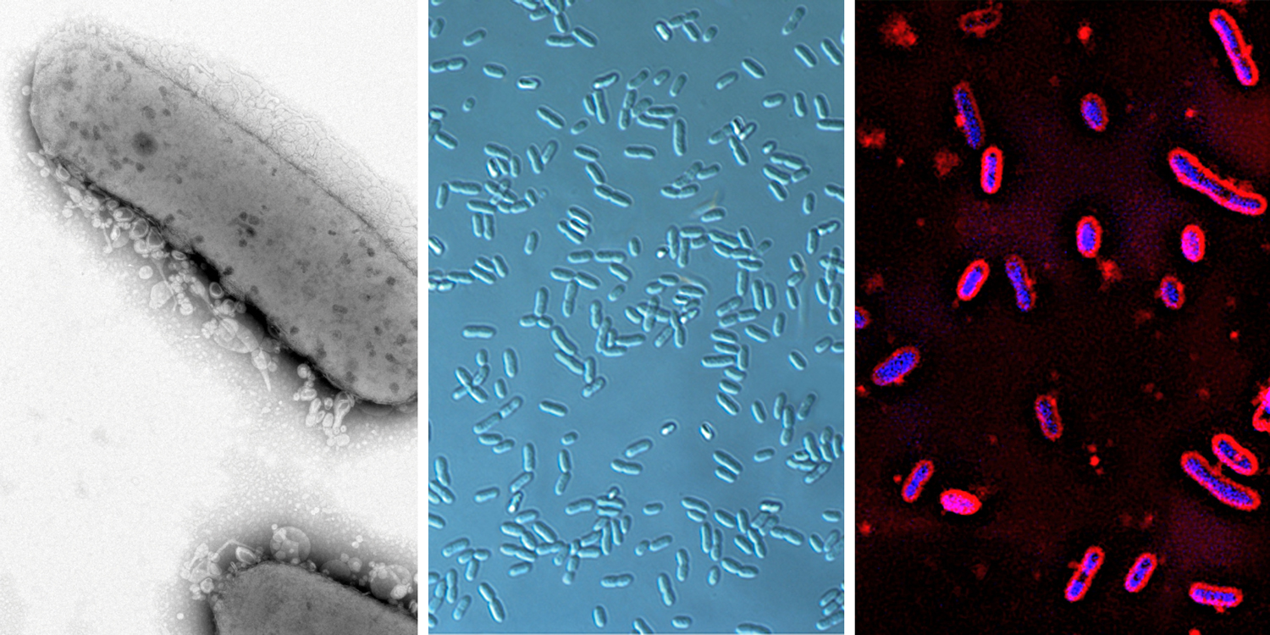
BRC Science Highlight
Uncovering new features of bacterial control elements
Objective Study the properties of promoters of new industrial chassis to gain insight into regulating genes in unique and promising biosynthetic microbes
Approach
Perform genome-scale transcription-translation identification and mapping using high-throughput sequencing
Investigate rRNA synthesis using in vitro transcription system with purified RNA polymerase
Rhodobacter sphaeroides, Zymomonas mobilis, and Novosphingobium aromaticivorans. Photos by Kim Lemmer, Katherine Pappas, and Miguel Perez
Result/Impacts
Most promoters in alphaproteobacteria lack a nucleotide present in 90-99% of promoters in other bacteria
These insights will enable genetic engineering in Z. mobilis, R. sphaeroides, and N. aromaticivorans
This is a crucial step for optimizing these bacteria for the bio-based production of fuels and chemicals
Vera, J.M. et al., “Genome-Scale Transcription-Translation Mapping Reveals Features of Zymomonas mobilis Transcription Units and Promoters,” mSystems 5:e00250-20 (2020). [DOI: 10.1128/mSystems.00250-20]
Myers, K.S. et al., “Genome-Wide Identification of Transcription Start Sites in Two Alphaproteobacteria, Rhodobacter sphaeroides 2.4.1 and Novosphingobium aromaticivorans DSM 12444,” Microbiology Resource Announcements 9 (36) e00880-20 (2020) [DOI: 10.1128/MRA.00880-20]
Henry, K.K. et al., “A majority of Rhodobacter sphaeroides promoters lack a crucial RNA polymerase recognition feature, enabling coordinated transcription activation,” Proceedings of the National Academy of Sciences (2020) [DOI: 10.1073/pnas.2010087117]
GLBRC November 2020

