Slide 1
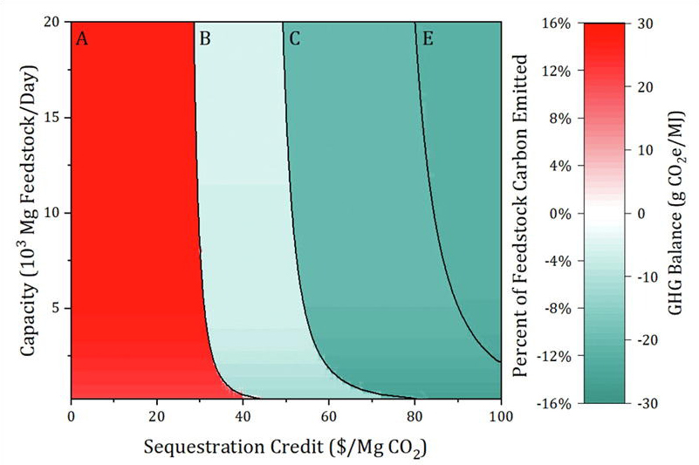
BRC Science Highlight
Optimizing for carbon storage: a new model for biorefineries
Objective Determine the impacts of bioenergy carbon capture and storage (BECCS) on economy, energy production, and environmental footprint of a biofuel refinery.
Approach
Model model biorefinery BECCS by estimating soil carbon fixation by three sample feedstocks (corn, switchgrass, and poplar) and carbon capture from fermentation, biogas, and flue gas combustion emissions.
Simulate impacts of various pretreatment methods combined with BECCS on carbon storage, biorefinery economic performance, and energy production.
Result/Impacts
Carbon capture technologies are interdependent with production methods, both of which affect energy production and environmental impacts.
Biorefinery profitability scale with a carbon credit in cases of (A) no capture, (B) capture from fermentation, (C) capture from fermentation and biogas, and (E) full capture from fermentation and biogas, with exactly enough capture from flue gas to neither purchase nor sell electricity.
Scenarios ultimately showed that larger cost-effective biorefinery operation can succeed when technologies are employed that don’t rely on grid electricity.
Geissler, CH, and Maravelias, CT. “Economic, energetic, and environmental analysis of lignocellulosic biorefineries with carbon capture.” Applied Energy 302, 117539 (2021) [DOI: 10.1016/j.apenergy.2021.117539]
GLBRC November 2021

