Slide 1
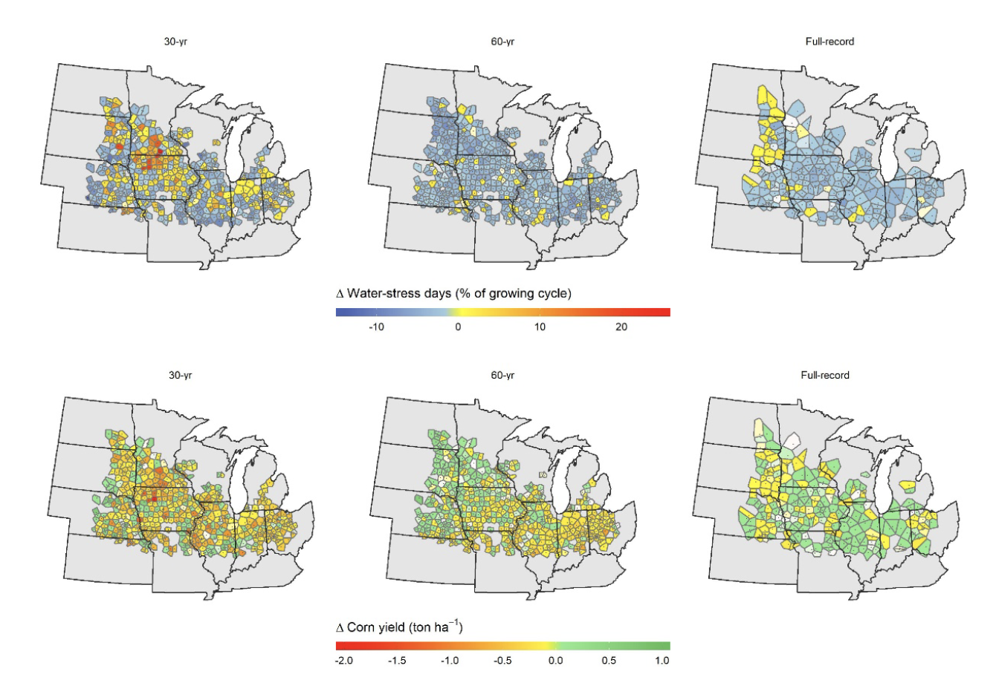
BRC Science Highlight
Planning for crop water needs under changing climate conditions
Objective Model crop water demand and yields in the Midwest under projected temperature trends to 2050
Approach
Evaluate long-term historical summer temperature changes in the Midwest based on observations recorded at 1,356 weather stations, some dating back as far as 1894.
Use a crop simulation model to predict changes in corn yield in 2050 using the temperature and precipitation trends of the past 125 years.
Result/Impacts
Average minimum temperatures in the region have increased and maximum temperatures have slightly decreased, leading to higher air humidity and a slight reduction in crop water demand.
The impacts of projected summer temperature and rainfall trends on water stress days and yields for corn grown in the Midwest over the past 30, 60, and 125 years. Projecting these trends out to 2050 suggests little change in crop water stress or yield in the next 30 years.
Modeling results show little change in crop water need or yield in the next 30 years.
Under the temperature trends projected through 2050, future yields of corn and other bioenergy crops in the Midwest may stay stable without need for expanded irrigation.
Basso, B., Martinez-Feria, R.A., Rill, L., and Ritchie, J.T., “Contrasting long-term temperature trends reveal minor changes in projected potential evapotranspiration in the US Midwest.” Nature Communications 12, 1476 (2021). [DOI: 10.1038/s41467-021-21763-7]
GLBRC March 2021
Department of Energy • Office of Science • Biological and Environmental Research
Notes:
Notes:
text
Title again:
Text 1-2 sentence summary?

