Slide 1
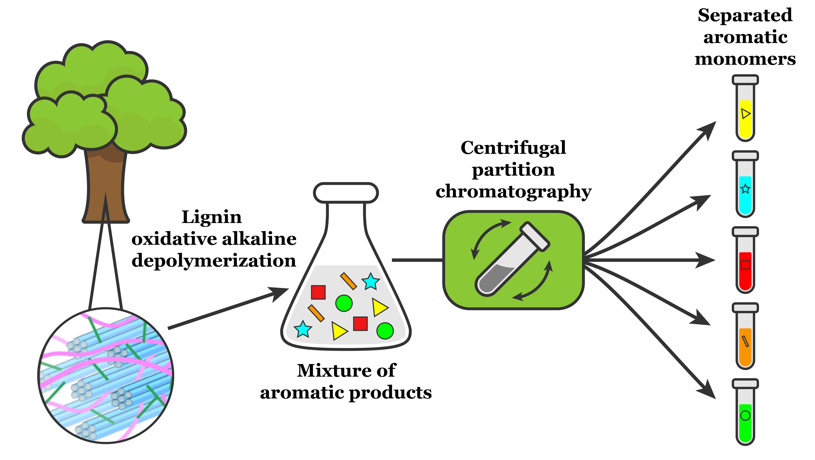
BRC Science Highlight
Isolating valuable compounds from complex mixtures of lignin products
Objective Use liquid-liquid extraction to isolate individual compounds from the complex product mixtures that result from lignin processing
Approach
Digest poplar lignin in the presence of oxygen to create a mixture of oxygenated aromatic compounds
Apply centrifugal partition chromatography to separate individual monomers based on their solubility in two non-mixing solvents
Centrifugal partition chromatography provides an effective strategy to separate valuable aromatic products obtained from lignin depolymerization mixtures.
Result/Impacts
Centrifugal partition chromatography successfully isolated vanillin, syringic acid, syringaldehyde, vanillic acid, and p-hydroxybenzoic acid in two stages of extraction.
The method requires only a few steps, uses no expensive added chemicals, and can be adapted to large-scale use, suggesting that it can provide a scalable way to isolate valuable industrial chemicals from lignin and other biomass-derived feedstocks.
Alherech, M., Omolabake, S., Holland, C.M., Klinger, G.E., Hegg, E.L., Stahl, S.S., “From lignin to valuable aromatic chemicals: lignin depolymerization and monomer separation via centrifugal partition chromatography.” ACS Central Science (2021) [DOI: 10.1021/acscentsci.1c00729]
GLBRC December 2021
Citation
Notes:
Notes:
text
Title again:
Text 1-2 sentence summary?

