Slide 1
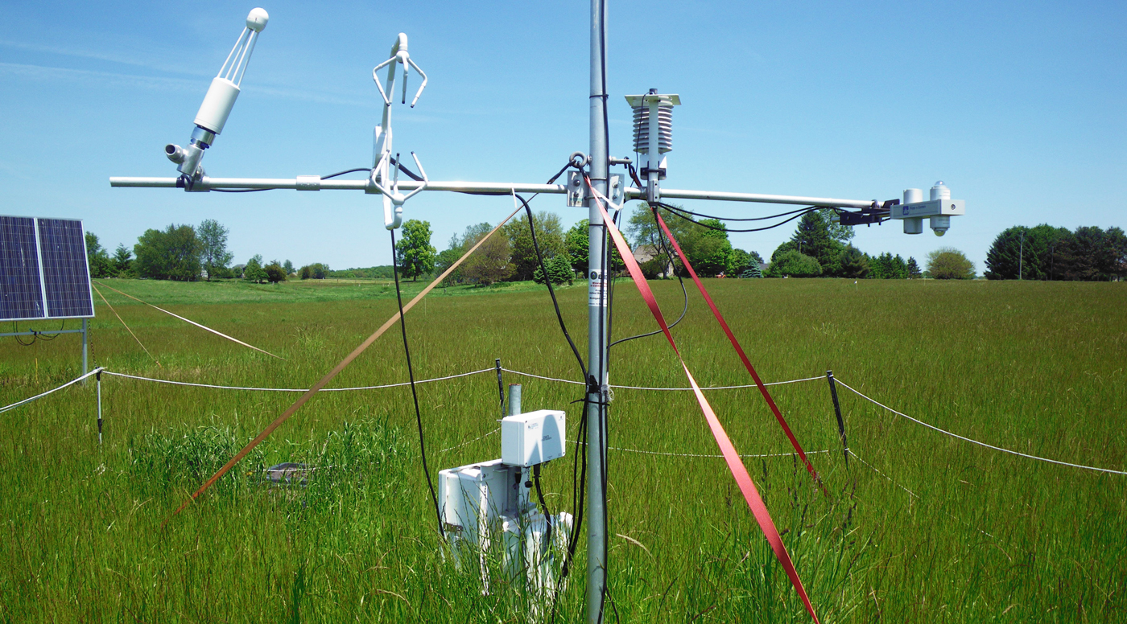
BRC Science Highlight
Bioenergy crops create local cooling that can increase climate benefit
Objective Determine the impact of albedo-induced climate mitigation from the conversion of Conservation Reserve Program (CRP) lands to bioenergy crops.
Approach
Measure a cropping system’s Global Warming Impact (GWI) based on uptake and release of carbon and nitrogen.
Calculate albedo, or surface reflectivity, and local climate cooling caused by bioenergy crops’ land conversion.
Instrument towers mounted with radiation sensors measured the surface albedo of cropping systems in four field sites in southwest Michigan at the Kellogg Biological Station over the course of eight years. Photo courtesy of Landscape Ecology and Ecosystem Science Lab.
Result/Impacts
Albedo differences for bioenergy crops are an important component for modeling the impacts of land conversion.
Switchgrass and restored prairie give a larger cooling effect for CRP lands than previously thought, but climate benefits from corn due to albedo offer little climate change mitigation.
Abraha, M., Chen, J., Hamilton, S., Sciusco, P., Lei, C., Shirkey, G., Yuan, J., Robertson, G.P., “Albedo-induced global warming impact of Conservation Reserve Program grasslands converted to annual and perennial bioenergy crops.” Environmental Research Letters 16:8 (2021) [DOI: 10.1088/1748-9326/ac1815]
Abraha, M., Gelfand, I., Hamilton, S., Chen, J., Robertson, G.P., “Carbon debt of field-scale conservation reserve programs grasslands converted to annual and perennial bioenergy crops.” Environmental Research Letters 14:2 (2019) [DOI: 10.1088/1748-9326/aafc10].
GLBRC October 2021

