Slide 1

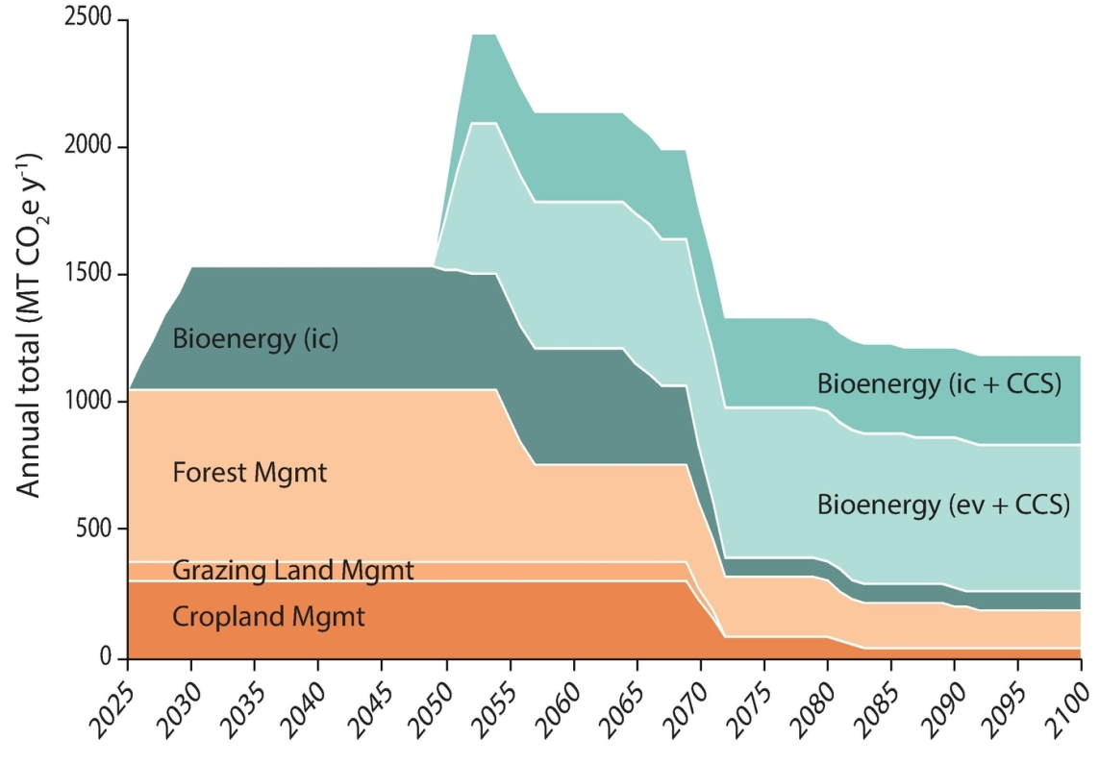
Integrating bioenergy production and land management practices can boost climate change mitigation
Background/Objective
Investigate climate mitigation potential for an integrated approach to land-based climate solutions that includes both cellulosic bioenergy production and natural climate solutions.
Approach
Model the climate mitigation potential of using specific land management practices known to reduce GHG levels on different portions of the U.S. landscape.
Results
Integrated land management approaches in the U.S. can mitigate the equivalent of approximately 110 (between 57-178) gigatons of carbon dioxide by 2100.
Combining these approaches to land use could reduce greenhouse gas levels 50% more than prior estimates
Significance/Impacts
The study shows that an integrated approach to land-based climate solutions in the U.S. has the potential to reduce GHG levels 50% more than prior estimates based on either bioenergy or natural climate solutions alone.
The study highlights the importance of pursuing bioenergy production as part of a portfolio of land-based climate mitigation strategies.
Robertson, G. P., Hamilton, S. K., Paustian, K., & Smith, P. (2022). Land-based climate solutions for the United States. Global Change Biology, 00, 1– 8. [DOI: 10.1111/gcb.16267]

