Slide 1
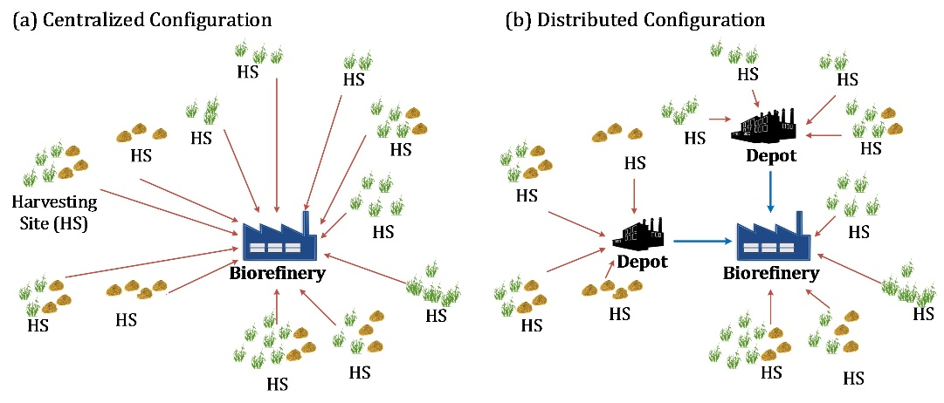
BRC Science Highlight
Design of biofuel supply chains with
regional depots
Objective
Perform simultaneous design and operational planning of biofuel supply chains with depots
Approach
Develop optimization model that accounts for geographically and temporally distributed biomass availability, intermediates produced at the regional depots (e.g. AFEX treated pellets) and shipped to the biorefinery, and final product demand specifications.
Model determines the optimal number, capacity, and location of depots and biorefineries, as well as the production, inventory, and shipment profiles along all the connections in the biofuel supply chain system so that the total annual cost is minimized.
Figure X. Biofuel Supply Chain Configuration
Result/Impacts
The amount of biomass to be converted to fuels is an optimization decision subject to availability constraints, and the biomass harvested in one site can in principle be shipped to different depots or biorefineries.
To account for realistic restrictions, the models can be modified to identify (near) optimal “static” configurations where all biomass from a site is shipped to a single downstream depot or biorefinery, if the harvesting site is selected; and the intermediate from each depot is shipped to only one biorefinery.
Ng RTL, Maravelias CT. “Design of Cellulosic Ethanol Supply Chains with Regional Depots”. I&EC Research (2016) [DOI: 10.1021/acs.iecr.5b03677]
Ng RTL, Maravelias CT. “Design of Biofuel Supply Chains with Variable Regional Depot and Biorefinery Locations”. Renewable Energy (2017) [DOI: 10.1016/j.renene.2016.05.009]
GLBRC December 2016
Notes:
Notes:
text
Title again:
Text 1-2 sentence summary?

