Slide 1
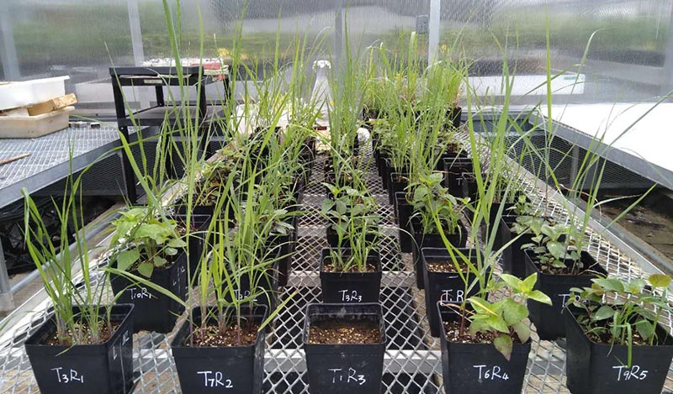
BRC Science Highlight
When it comes to soil carbon storage, a plant’s neighbors could make all the difference
Objective Determine whether some Midwest prairie perennials, including the bioenergy crop switchgrass, can increase carbon in soils when grown near other plant species.
Approach
Track stable-isotope carbon as it moves between root systems of potted switchgrass, big bluestem, and wild bergamot planted in various pairs.
Compare carbon stored in soils of each plant pairing.
Measure soil pore formation and the presence of fungi that are beneficial to carbon accrual.
Result/Impacts
Certain plant pairs transferred more carbon to each other through their roots.
Higher levels of carbon exchanged between root systems corresponded with increased soil pores and more carbon accrual in the soil.
Researchers tracked carbon exchanged between root systems and in the soil in pots of switchgrass, big bluestem, and wild bergamot planted alone and in pairs with one another.
These measurements explain how plant diversity and the presence of certain species grown side-by-side impact soil carbon, allowing farmers to design cropping and grazing systems that could more effectively move carbon from the air to the soil.
Kravchenko, A.N., Zheng, H., Kuzyakov, Y., Robertson, G. P., and Guber, A.K., “Belowground interplant carbon transfer promotes soil carbon gains in diverse plant communities.” Soil Biology and Biogeochemistry 159, 108297 (2021) [DOI: 10.1016/j.soilbio.2021.108297]
GLBRC July 2021

