Slide 1
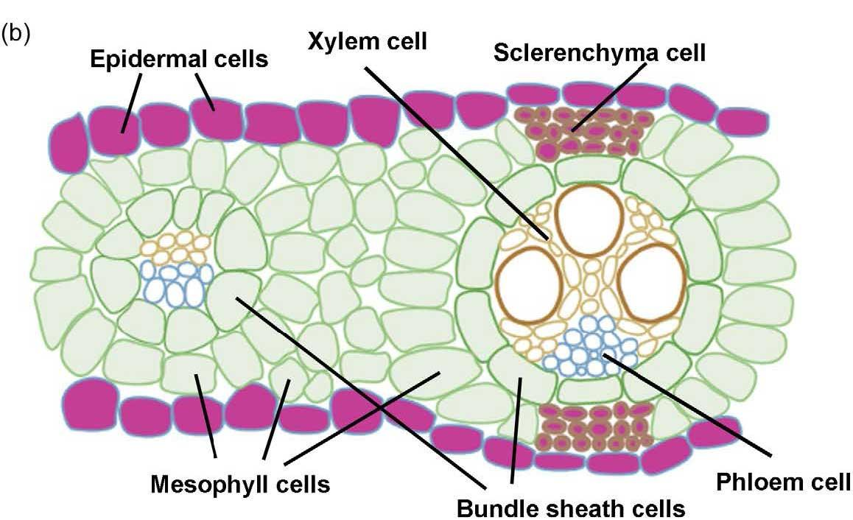
Unlocking the mysteries of mixed-linkage glucan
BRC logo here
Background/Objective
To understand the mechanisms that regulate production and degradation of a type of sugar called mixed-linkage glucan (MLG) in plants like sorghum.
Approach
Scientists with the Great Lakes Bioenergy Research Center identified three sorghum proteins similar to known lichenases in barley and a related grass called Brachypodium.
Developmental MLG synthesis and degradation occur in mesophyll and bundle sheath cells. Continuous MLG synthesis and degradation occurs in the epidermal and sclerenchyma cells (purple cells).
Results
Researchers showed the enzymes can digest MLG and were secreted into the apoplast, the space between neighboring cells, consistent with the biological role of a lichenase that degrades MLG in the cell wall.
Significance/Impacts
Understanding the role and mechanism of MLG regulation could help scientists engineer bigger, faster-growing plants that store more carbon inside the cell walls and are more easily converted into biofuels.
Kim, Sang-Jin, et al. Cell- and development-specific degradation controls the levels of mixed-linkage glucan in sorghum leaves. The Plant Journal 116, 360-374 (2023). [DOI:10.1111/tpj.16376]

