Slide 1

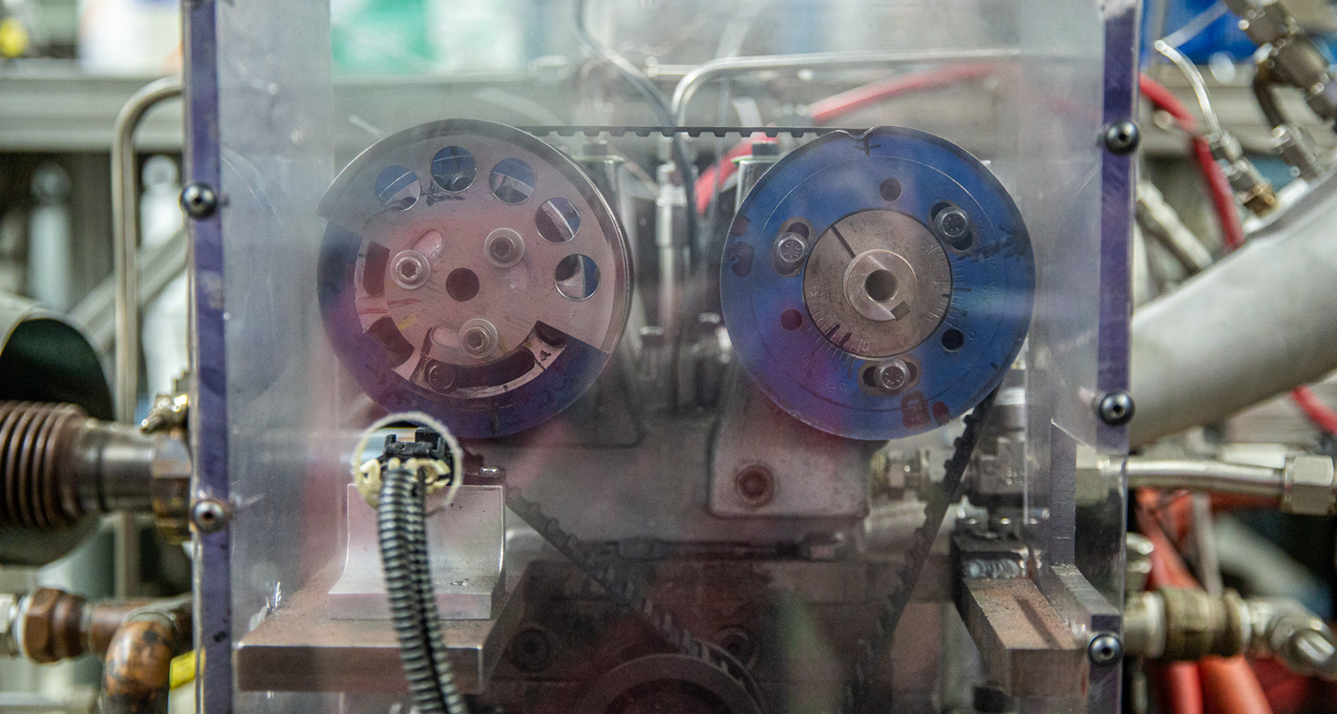
Methylbutenol outperforms ethanol, isobutanol as gasoline additive
BRC logo here
Background/Objective
Evaluate sooting and anti-knock properties of three biofuel additives in an internal combustion engine.
Approach
Measured particulate matter and knock resistance of ethanol, isobutanol, and methylbutenol blended with gasoline at three concentrations based on oxygen weight.
A single-cylinder spark-ignition engine was used to test the sooting and knock-resistance properties of three types of alcohol blended with gasoline.
Results
At high concentrations, methylbutenol, a type of alcohol produced by some North American pine trees, created less soot and resisted engine knock better than isobutanol or ethanol.
Significance/Impacts
Isobutanol and methylbutenol are more similar to gasoline than ethanol, and both can be produced from non-food plants using modified bacteria, making them attractive low-carbon replacements for fossil fuels.
Sakai, S., & Rothamer, D. Relative particle emission tendencies of 2-methyl-3-buten-2-ol–gasoline, isobutanol–gasoline, and ethanol–gasoline blends from premixed combustion in a spark-ignition engine, Fuel 324, 124638 (2022). [DOI:10.1016/J.FUEL.2022.124638]
Sakai, S., & Rothamer, D. Auto-ignition propensity of ethanol-, isobutanol-, and 2-methyl-3-buten-2-ol-gasoline blends under premixed prevaporized conditions in a spark-ignition engine. Combustion and Flame 251, 112685 (2023). [DOI:10.1016/J.COMBUSTFLAME.2023.112685]

