Slide 1
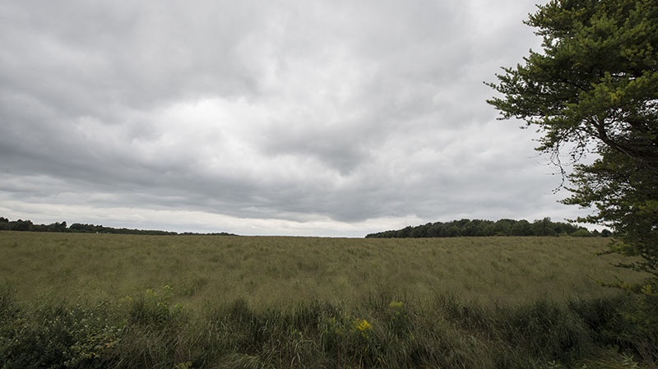
Bioenergy crops reduce carbon emissions – if grown on the right land
BRC logo here
Background/Objective
Estimate the global warming intensity (GWI) and greenhouse gas mitigation potential of biofuel produced from switchgrass grown on marginal land
Approach
Modeled crop yields and soil organic carbon levels resulting from planting switchgrass on recently-tilled abandoned farm fields and other marginal lands in Michigan grown with and without fertilizer.
A field of switchgrass at Michigan State University’s Kellogg Biological Station.
Results
These lands could produce more than 150 million gallons of biofuels from nitrogen-fertilized switchgrass, of which 96% meet the Renewable Fuel Standard and 73%–75% are carbon negative. However, carbon storage decreases in carbon-rich soils like wetlands, resulting in biofuel with higher GWI than gasoline.
Significance/Impacts
This research highlights the strong climate mitigation potential of biofuel derived from switchgrass grown on marginal lands as well as the need to avoid planting in carbon-rich soils.
Kim, S., et al. Global warming intensity of biofuel derived from switchgrass grown on marginal land in Michigan. GCB Bioenergy (2023). [DOI: 10.1111/gcbb.13024]

