Slide 1
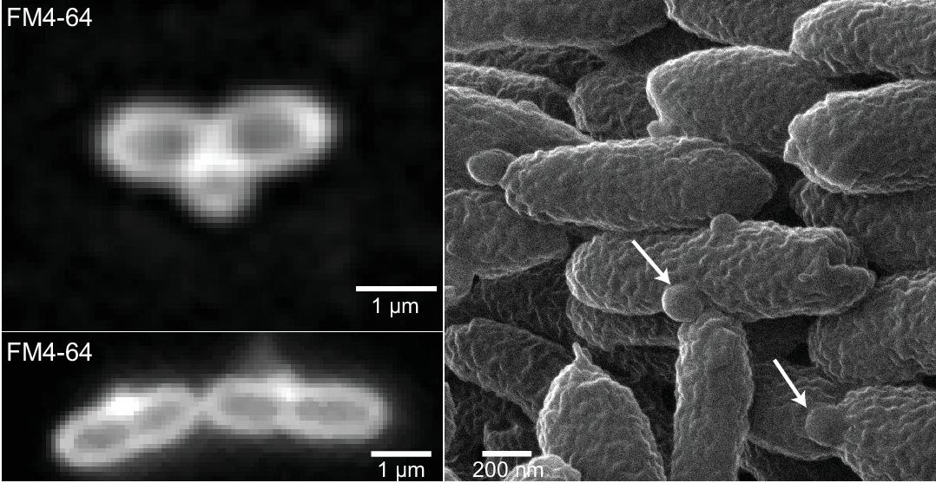
Studies offer clues to how bacteria shed fat
BRC logo here
Background/Objective
Understand how changes in cell envelope formation, growth, and division leads to bacterial lipid secretion.
Approach
Researchers used high-resolution microscopy and 3-D imaging to link cell envelope changes to lipid secretion in cells with increased activity of a master regulator or lacking a part of the cell division machinery.
Fluorescence images of ΔdalA cells stained with FM4-64 (left). Helium-ion microscopy image of the same strain (right) showing OM protrusions (white arrows).
Results
Increasing CenK activity caused cells to secrete lipids because of defects in the outer membrane and the peptidoglycan, a mesh-like structure that forms the cell wall. Mutants of a previously uncharacterized protein, named DalA, that is part of a scaffold to build this mesh secrete lipids form the site of cell division.
Significance/Impacts
Oils produced by microbes could provide a source of renewable alternatives to petroleum-derived compounds, such as lubricants and jet fuel. These studies report new ways to increase bacterial lipid secretion.
Alberge, François, et al. A previously uncharacterized divisome-associated lipoprotein, DalA, is needed for normal cell division in Rhodobacterales. MBio, e0120323 (2023). [DOI:10.1128/mbio.01203-23]
Lakey, Bryan D., et al. The role of CenKR in the coordination of Rhodobacter sphaeroides cell elongation and division. MBio, e0063123 (2023). [DOI:10.1128/mbio.00631-23]

