Slide 1

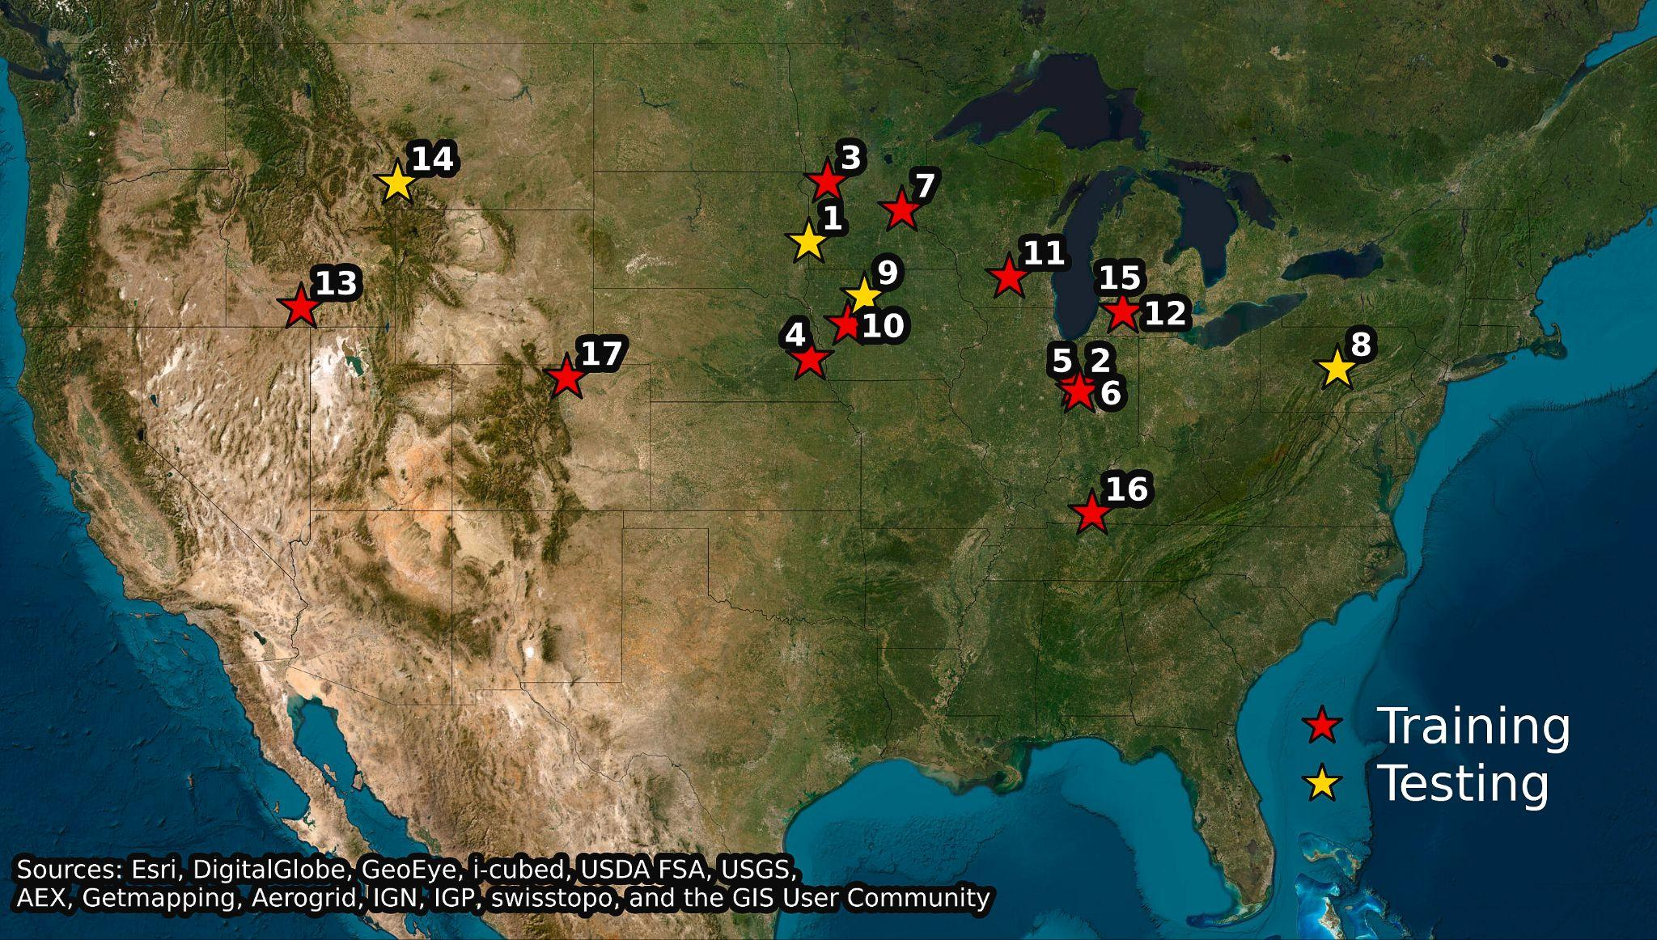
Machine learning-ecosystem ensemble models improve nitrous oxide flux predictions
Background/Objective
Nitrous oxide (N₂O) is a potent greenhouse gas with rising atmospheric concentration driven in part by inefficient use of nitrogen fertilizer. High spatial and temporal variability arising from complex biogeochemical processes make predicting N₂O emissions challenging. Both process-based models and machine learning (ML) approaches often miss high-flux episodes. This work sought to establish an ensemble modeling system (EMS) capable of accurately representing daily N₂O dynamics across diverse sites and agricultural management practices and identifying variables and thresholds driving emissions.
Approach
Scientists combined five process-based ecosystem models (APSIM, EPIC, SALUS, DSSAT, and STICS) to provide daily plant and soil properties that were used as input data for four blended ML models (Random Forest, Gradient Boosting, Support-Vector Regression, and XGBoost). The EMS was trained and validated with 12,181 N₂O measurements at 17 sites across the U.S. Midwest and Great Plains spanning six crops and 35 management practices.
Experiment locations. Red stars indicate 13 sites used for model training and cross-validation; yellow stars represent sites reserved for out-of-sample testing.
Results
The EMS accurately predicted daily N₂O fluxes at both training and held-out testing sites. Analyses identified six dominant N₂O drivers: soil organic carbon, NH₄+, NO₃-, water-filled pore space, temperature, and aboveground biomass production. Wet, warm soils produced large N₂O peaks only with sufficient SOC and mineral N. Incorporating these drivers into process-based models may significantly improve predictive capacity.
Significance/Impacts
By offering enhanced accuracy, transferability, and transparency, this proof-of-concept approach could provide a means for refining national GHG inventories and informing effective field-specific N₂O mitigation strategies.
Sharma, P., et al. Coupled machine learning–ecosystem ensemble models substantially improve predictions of nitrous oxide (N2O) fluxes from US croplands. Proceedings of the National Academy of Sciences, 123, e2524808123. (2026). [DOI:10.1073/pnas.2524808123]

