Slide 1
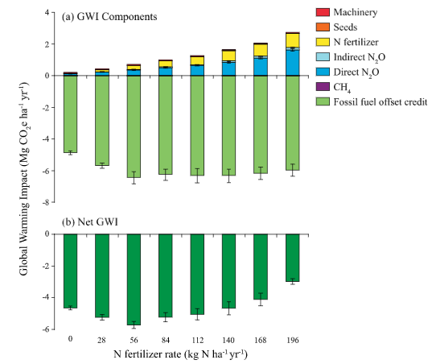
BRC Science Highlight
Fertilizer use could reduce climate benefit of cellulosic biofuels
Objective
To study the effect of nitrogen fertilization on climate change mitigation benefits of cellulosic biofuels.
Approach
Multi-year testing of direct and indirect N₂O emissions, CH₄ oxidation, NO₃- leaching, soil organic carbon accumulation, and biomass production in recently established (2008) switchgrass fertilized at different N rates.
Result/Impacts
Relationship between fertilizer vs. nitrate leaching and N₂O production shows an exponential relationship such that at N
rates greater than crop need there is much more N₂O produced
and NO₃ leached than expected; this is probably due to
less competition between plants and microbes at high N rates.
This disproportionality can change the math on biofuel crops’ net climate benefit: the climate benefits of over-fertilized switchgrass can be reduced by almost 50% once the fertilizer’s production, use, and N₂O emissions are subtracted from the crop’s carbon benefit.
Designing biofuel crops for low N needs and fertilizing only as needed, if at all, will be an important strategy for the biofuel industry to meet the full climate mitigation benefits of cellulosic biofuels.
Annual global warming impacts (GWI; based on overall GHG balances) for switchgrass production across an N fertilizer gradient. (a) GWI components including fossil fuel offset credits for displacement of gasoline by biofuel; (b) net GWI.
Ruan, L, Bhardwaj AK, Hamilton SK, Robertson GP. “Nitrogen fertilization challenges the climate benefit of cellulosic biofuels”. Environmental Research Letters (2016) [DOI: 10.1088/1748-9326/11/6/064007]
GLBRC July 2016
Notes:
Notes:
text
Title again:
Text 1-2 sentence summary?

