Slide 1
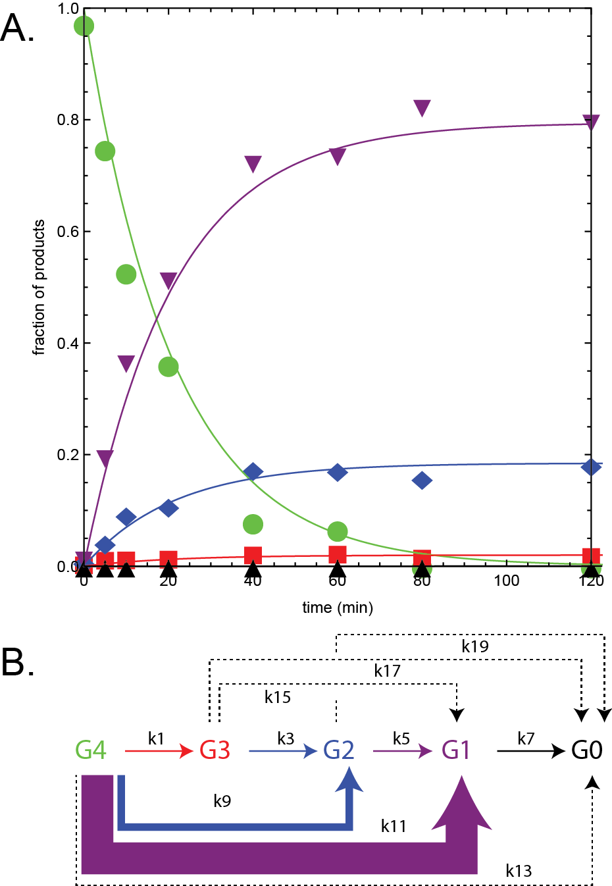
BRC Science Highlight
Use of nanostructure-initiator mass spectro-metry to deduce selectivity of reaction in glycoside hydrolases
Objective To improve the annotation of glycoside hydrolases (GH) phylogenetic trees.
Approach
Collaboration between GLBRC and JBEI.
Chemically synthesized nanostructure-initiator mass spectrometry (NIMS) probes derivatized with tetrasaccharides were used to study the reactivity of β-glucosidase, endoglucanase, and cellobiohydrolase; which are representative enzymes for understanding GH function.
Automated protein translation with high-sensitivity detection of multiple products and time-dependent detection of their formation.
Result/Impacts
Research chemically synthesized mass probes provide a predictive approach for characterization of GH function.
Synthesized genes, robotic cell-free translation, automation given by the Nimzyme platform, and numerical analysis give a powerful new approach for functional annotation of bioenergy phylogenetic space.
A. Numerical analyses the reaction of multifunctional cellulase CMX00 with cellotetraose NIMS. Cellotetraose- (green), cellotriose (red), cellobiose- (blue), glucose- (purple) and aglycone-NIMS (black). B. Relative apparent rates determined by numerical analysis indicated by width of arrows in the kinetic scheme accounting for all observed products. A dashed line indicates that the apparent rate was zero.
Deng K, Takasuka TE, Bianchetti CM, Bergeman LF, Adams PD, Northen TR, Fox BG. “Use of nanostructure-initiator mass spectrometry to deduce selectivity of reaction in glycoside hydrolases”. Frontiers in Bioengineering and Biotechnology (2015). 290 (19):11819.
GLBRC January 2016
Notes:
Notes:
text
Title again:
Text 1-2 sentence summary?

