Slide 1

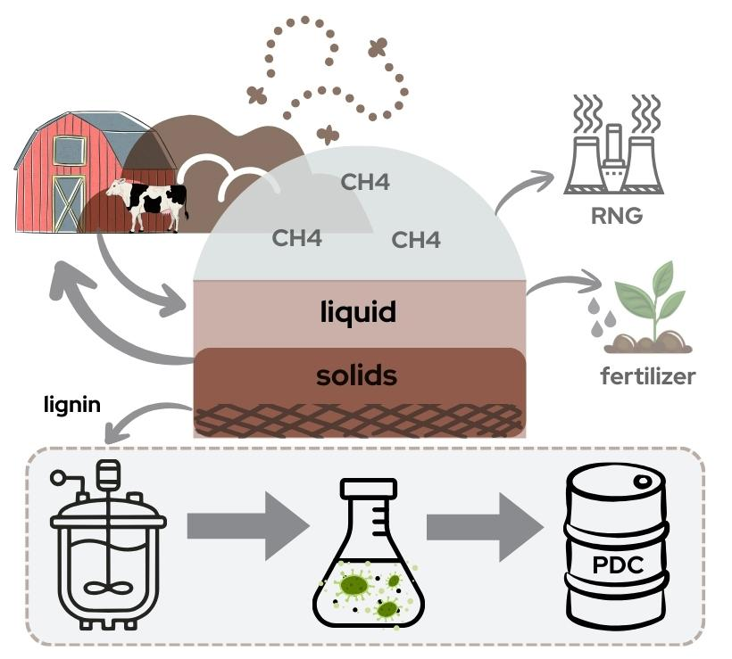
Production of lignin-derived biochemicals from post-anaerobic digestion manure fibers
Background/Objective
Anaerobic digestion of manure produces methane gas and a digestate residue consisting of a liquid fraction used as fertilizer and a solid fraction (fibers) utilized as soil amendment and animal bedding. This study sought to identify the lignin content and aromatic composition of post-digestion manure fibers and evaluate the potential for microbial funneling to value-added products.
Approach
Researchers performed compositional analysis and nuclear magnetic resonance to determine the lignin content and aromatic composition of post-digestion fibers and evaluated two processes for producing aromatic-rich streams from the fibers: alkaline-based treatment and reductive catalytic fractionation (RCF). Alkaline pretreatment liquors were used for microbial upgrading to produce 2-pyrone-4,6-dicarboxylic acid (PDC).
Results
Results showed lignin represents ~30% of the biomass by dry weight, comparable to whole plant biomass. RCF treatment produced 14 g aromatics/kg fibers; alkaline treated fibers produced 5.6 g aromatics/kg fibers. Bioconversion by Novosphingobium aromaticivorans in a fed-batch bioreactor produced a yield of ~1 mol of PDC/mol measured aromatics at a rate of 0.2 g PDC/L∙h and a titer of 2.6 g PDC/L.
The solid residue that remains after anaerobic digestion of manure contains ~30% lignin, which can be depolymerized for microbial funneling to PDC.
Significance/Impacts
U.S. beef and dairy cattle produce 43 million metric tons of manure annually. This study demonstrates that lignin aromatics remain after anaerobic digestion of dairy manure and that they can be extracted for production of value-added products such as PDC in support of a circular bioeconomy.
Riascos, B. D., et al. Postanaerobic Digestion Manure Fibers as a Renewable Source of Lignin-Derived Aromatic Compounds for Microbial Upgrading. ACS ES&T Engineering. (2026). [DOI:10.1021/acsestengg.6c00440]

