Slide 1

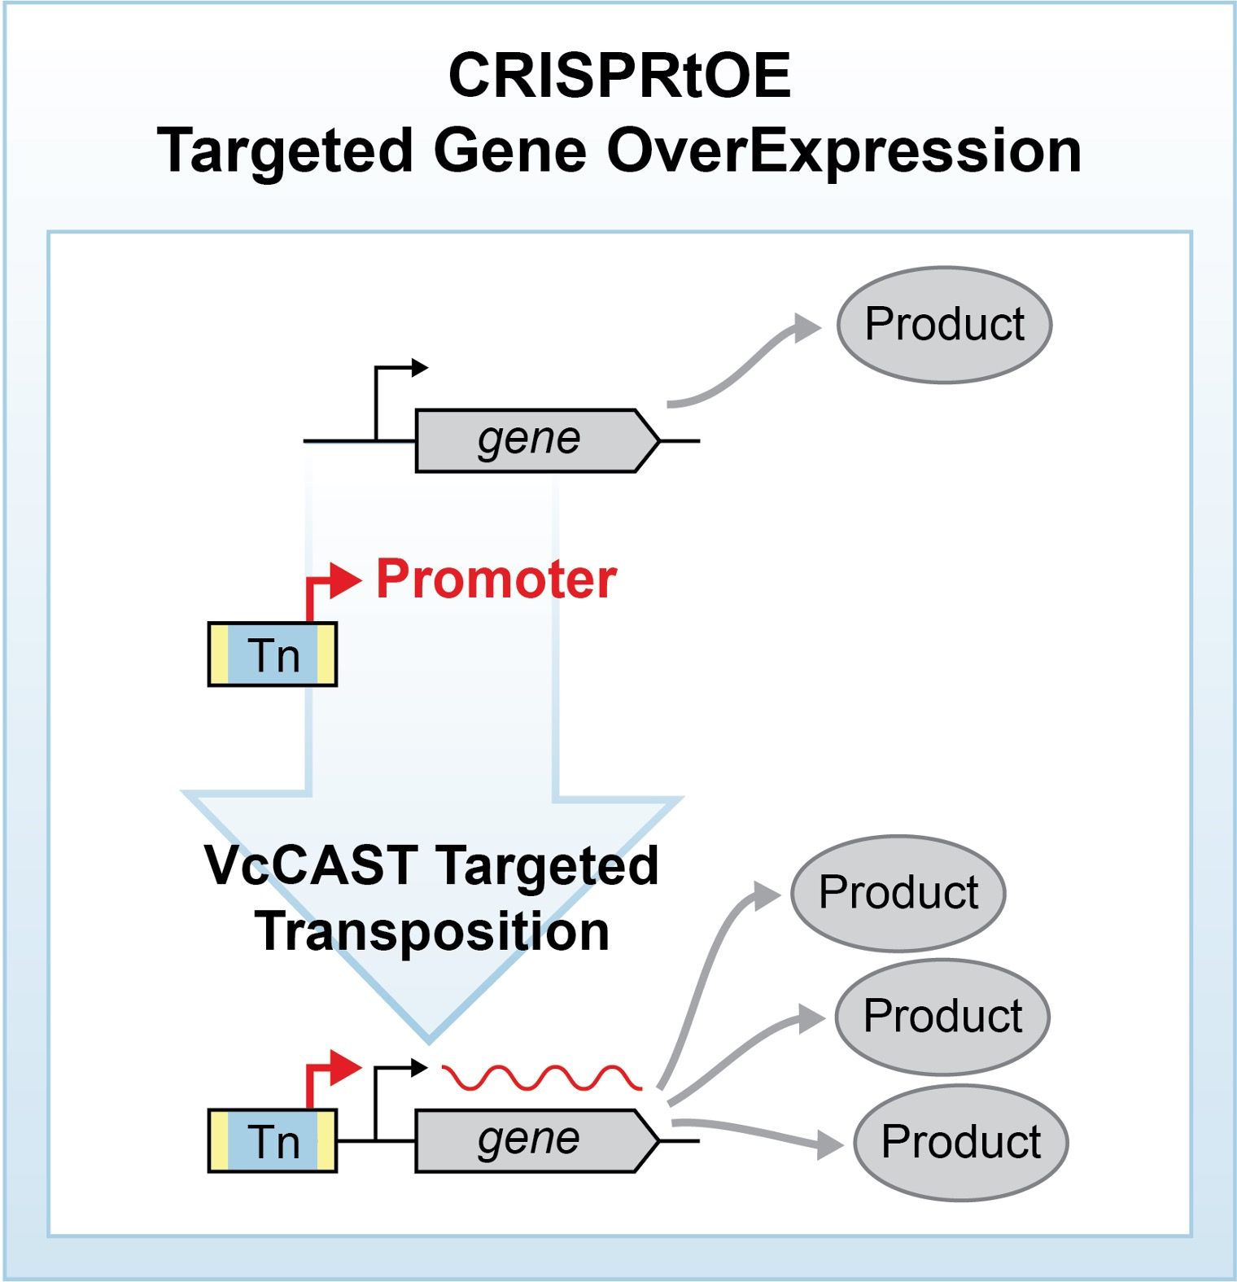
Gene overexpression tool for Protobacteria advances basic science and applied biodesign
Background/Objective
Targeted, genome-scale screens using clustered regularly interspaced short palindromic repeats interference (CRISPRi) and activation (CRISPRa) have revolutionized eukaryotic genetics, advancing medical, industrial, and basic research. While CRISPRi has been used for gene knockdowns in bacteria, options for genome-scale over-expression have been limited.
Approach
Scientists with the Great Lakes Bioenergy Research Center developed a facile approach for bacterial genome-scale over-expression known as CRISPR transposition and OverExpression (CRISPRtOE) and demonstrated that it can upregulate gene expression in medically and industrially relevant Protobacteria by integrating synthetic promoters of varying strength upstream of target genes.
Results
Researchers created a platform for comprehensive gene targeting using CRISPR-associated transposons (CASTs) and showed that transposition occurs at higher frequency in non-transcribed DNA. They showed CRISPRtOE can upregulate gene expression in medically and industrially relevant Proteobacteria by integrating synthetic promoters of varying strength upstream of target genes. They employed genome-scale CRISPRtOE screening in Escherichia coli K-12, recovering known and novel antibiotic targets, and in the non-model biofuel producing Zymomonas mobilis to define a potential engineering target (rpoE a.k.a. ecfZ) to overcome bioproduction stress.
CRISPR transposition and overexpression (CRISPRtOE) precisely delivers a transposon with an outward-facing promoter upstream of genes to facilitate overexpression.
Significance/Impacts
Systematic alteration of bacterial gene expression enables identification of genes relevant to diverse fields of study and practical applications, but there are few established facile approaches for systemic overexpression in bacteria. This approach can be used to systematically overexpress genes in both model and non-model Protobacteria, making it a valuable tool for both basic biology and applied biodesign, including industrial strain optimization.
Banta, A. B., et al. Targeted, genome-scale overexpression in Proteobacteria. mBio, e02340-25. (2026). [DOI:10.1128/mbio.02340-25]

