Slide 1

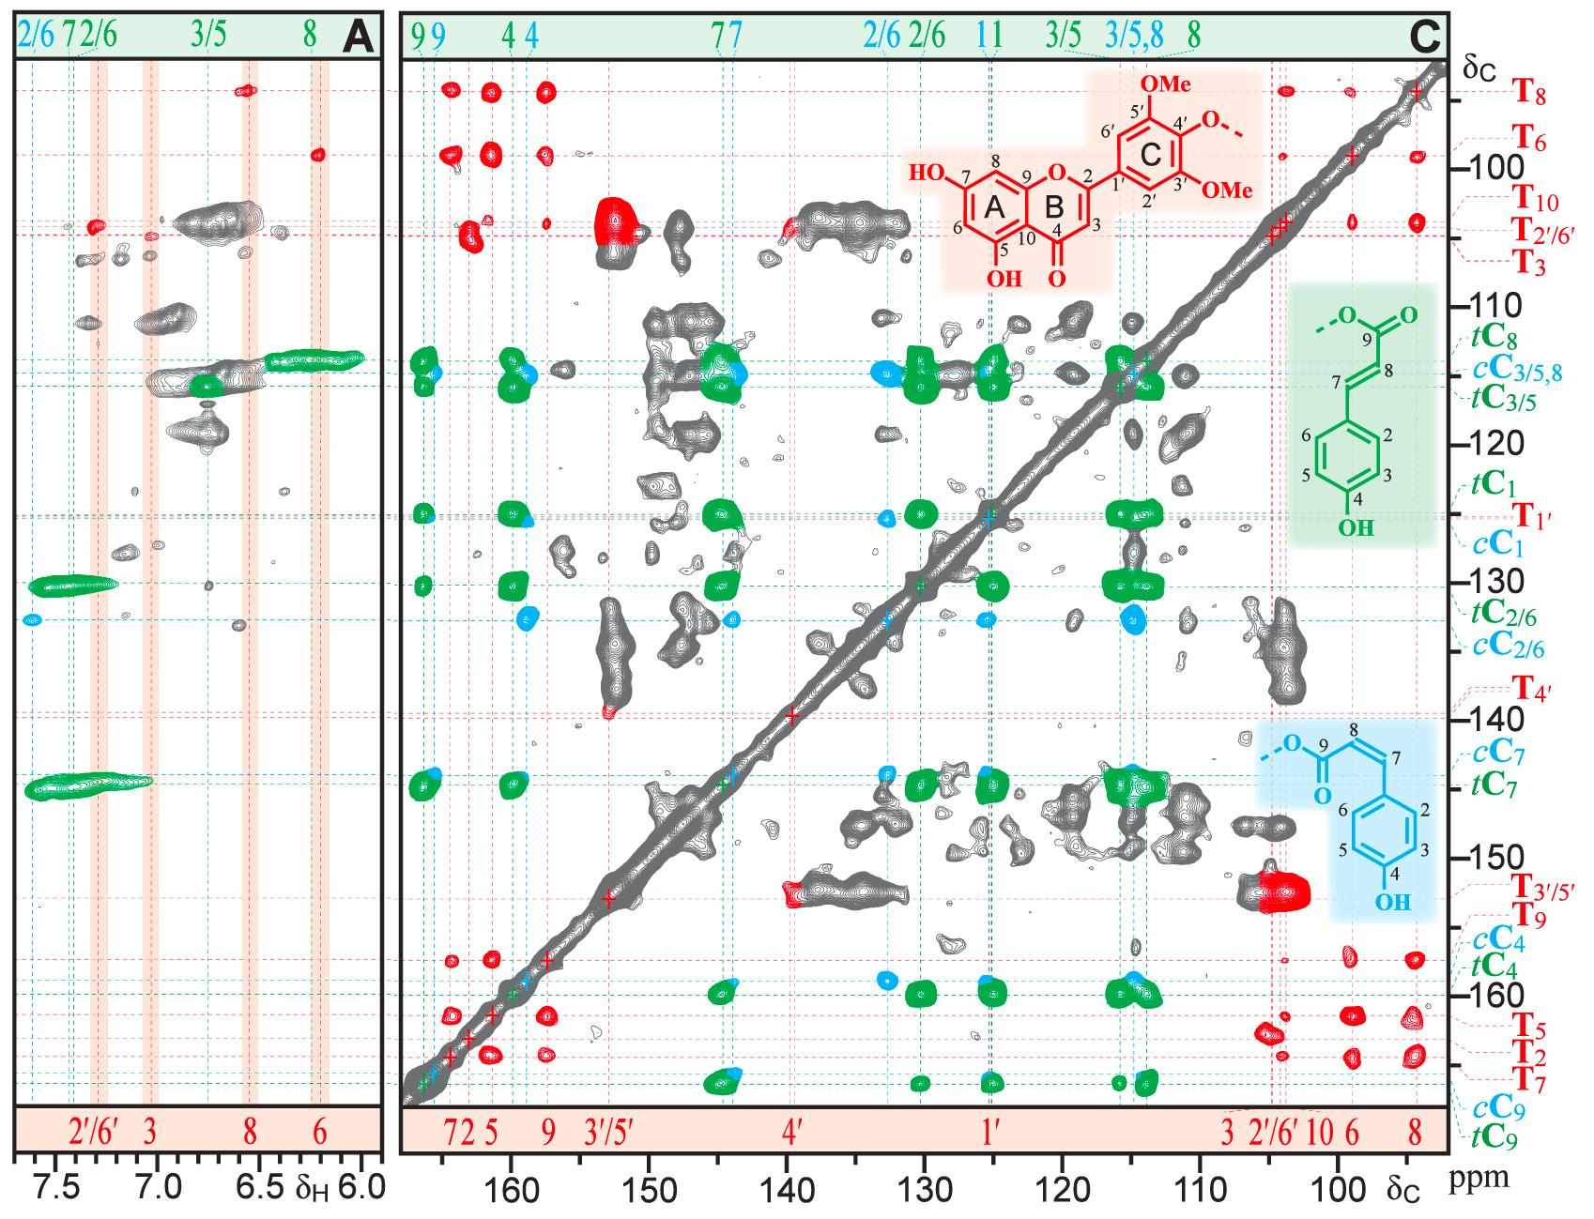
NMR of fully ¹³C-enriched biomass enhances pendent group structure characterization
Background/Objective
Traditional solution-state nuclear magnetic resonance (NMR) spectroscopy experiments may fail or yield unsatisfactory results when employing fully ¹³C-labeled biomass due to complications from ¹³C–¹³C coupling.
Approach
Researchers carried out NMR experiments using ¹³C-enriched poplar, sorghum, and maize straw.
Results
A rarely-reported CT-HSQC-TOCSY experiment allows the proton coupling network to deliver much of the same value as the parent experiment on unlabeled or 10-15% ¹³C-enriched biomass polymers, but with enhanced sensitivity. A C–C FLOPSY experiment takes advantage of fully ¹³C-labeled materials for mapping extensive carbon networks in complex biomass polymers. Various pendent groups (tricin units, cis- and trans-p-coumarates, and p-hydroxybenzoates) that adorn lignins, and the cis- and trans-ferulates on arabinoxylan polysaccharides are exquisitely revealed in spectra from isolated lignins or whole-cell-wall materials. The C–C FLOPSY experiment has significant additional value for studies on fully ¹³C-labeled biomass due to its superior applicability to readily prepared cell wall samples. Its shorter pulseprogram profile enables the acquisition of impressive spectra from rapidly relaxing samples for which traditional experiments fail.
(A) Partial HSQC spectrum from a 10%-¹³C-enriched maize stover EL that avoids the issue of ¹³C–¹³C coupling. (C) Aromatic and ester carbonyl region from the C–C-FLOPSY spectrum of 100%-¹³C-enriched maize straw lignin.
Significance/Impacts
This study demonstrates how two NMR experiments can be applied to deliver clearer and more detailed pictures of plant polymers, which can help researchers better understand what compounds are in plant biomass as well as how they are arranged.
Ralph, J., et al. NMR of Fully and Partially ¹³C-Enriched Biomass Enhances Pendent Group Structural Characterization. Analytical Chemistry, 98, 19482–19492. (2026). [DOI:10.1021/acs.analchem.5c08043]

