Slide 1

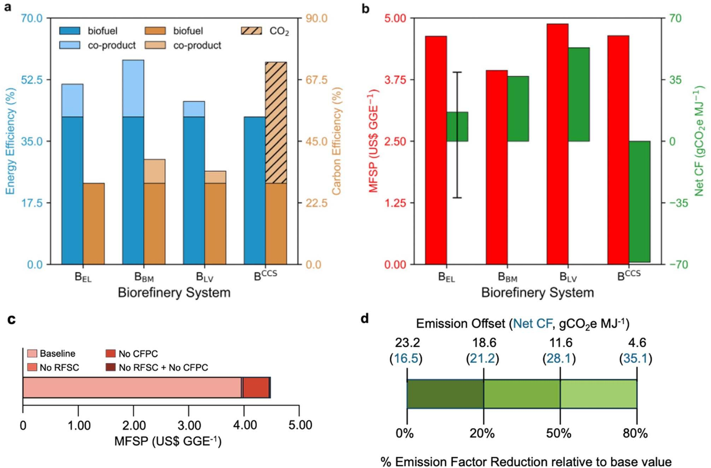
Study evaluates strategies for using energy-rich side streams in lignocellulosic biorefineries
Background/Objective
Lignocellulosic biorefineries generate energy-rich side streams, including biogas, lignin, and conversion residues. Capturing chemical energy from these side streams can improve economic and environmental performance. This study sought to assess and compare lignocellulosic biorefinery strategies, identify key drivers, evaluate trade-offs, and draw insights into system performance.
Approach
Researchers used modeling and optimization to evaluate energy and carbon efficiencies, cost, and carbon footprint (CF) of three baseline strategies: electricity generation, biogas upgrade to biomethane, lignin valorization; as well as carbon capture and storage (CCS). They further investigated the impacts of key parameters on system economics and CF as well as implications of geographic variability in co-product selling price of biomethane and electricity.
Results
Results showed that with current financial incentives for renewable fuel production, coproduction of biomethane leads to the highest energy efficiency (58%) and the lowest minimum fuel selling price (MFSP) for the main product,
Metrics of three baseline systems along with carbon capture and storage.
ethanol, 15% to 55% lower than electricity generation. Among co-production systems, electricity sold to the grid is the most sustainable option with net CF of 16.5 g CO2e per MJ. Biomethane co-production is economically preferred in more than 45 U.S. states under current market conditions. However, electricity co-production is preferred in states with high electricity prices. Overall, CCS achieves the lowest net CF. Using natural gas to capture CO2 carries a marginal abatement cost of $55 per mg CO2, suggesting that using natural gas may be environmentally and economically favorable, though this approach results in the release of fossil-based emissions. Lignin valorization results in the highest CF and MFSP because of additional materials required for lignin depolymerization.
Significance/Impacts
This study provides the first insights into which energy utilization strategies are most favorable across various conditions and locations, which can inform investment, siting, and policy decisions around the construction of second-generation lignocellulosic biorefineries. The findings also highlight the importance of aligning financial incentives, emission reduction targets, and regional resources to speed up commercial deployment and scale up of domestic biofuel production.
Aboagye, E. A., & Maravelias, C. T. Energy utilization strategies in lignocellulosic biorefineries. RSC Sustainability, 4, 2893–2903. (2026). [DOI:10.1039/d6su00050a]

