Slide 1

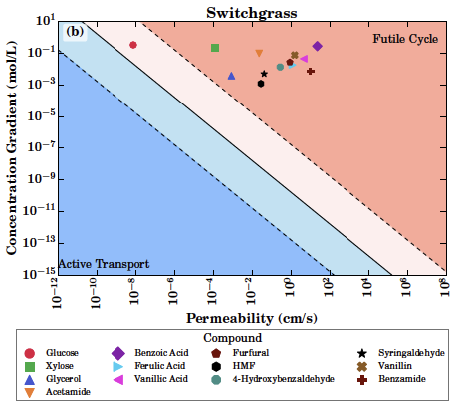
Molecular dynamics simulations show most lignocellulosic inhibitors overwhelm efflux
Background/Objective
Conversion of lignocellulosic biomass to biofuels and bioproducts is limited by small inhibitory molecules generated during pretreatment that inhibit microbial growth by disrupting microbial membranes. Zymomonas mobilis combines high ethanol productivity with solvent tolerance, yet hydrolysate compounds still inhibit growth. One mitigation strategy is to pump these molecules out through active transport processes; but if passive permeation rates are high, active transport would create a futile cycle where the exported molecules diffuse back in, creating a net drag on fitness.
Approach
Scientists used atomistic molecular dynamics simulations to measure the passive permeation for thirty-three lignocellulose derived compounds found in hydrolysates, including aldehydes, carboxylic acids, phenolics, and alcohols. These molecules span chemical space and each pose a unique challenge to the cell.
Results
Permeability coefficients spanned more than eight orders of magnitude driven largely by the balance between hydrophobicity and polarity. Hydrophobic inhibitors such as aromatic acids, aldehydes and short chain alcohols readily partitioned into the membrane and showed high permeability consistent with rapid passive influx and strong toxicity. Most polar molecules have lower but still appreciable permeation rates, with only the most polar sugars having low permeabilities. Integrating these predictions with hydrolysate composition information suggests most of these molecules are so permeable that futile cycles where passive permeation overwhelms efflux is highly likely. Engineering better small molecule transporters in the inner membrane is unlikely to improve microbial conversion unless the lipid bilayer itself is engineered to have a lower permeability coefficient.
Permeability coefficients for inhibitors in switchgrass hydrolysate
Significance/Impacts
Efficient production of biofuels and biochemicals from lignocellulosic biomass remains a key objective for industrial biorefineries, and reducing inhibition is essential to lowering cost. These findings provide a predictive framework for strain engineering, highlighting that lowering hydrolysate inhibitor concentrations through dilution may be the most effective strategy.
Singh, N. K., & Vermaas, J. V. Quantifying Membrane Structure and Dynamics during Bioproduct Production in Zymomonas mobilis by Molecular Simulation. The Journal of Physical Chemistry B. (2026). [DOI:10.1021/acs.jpcb.5c06231]

