Slide 1

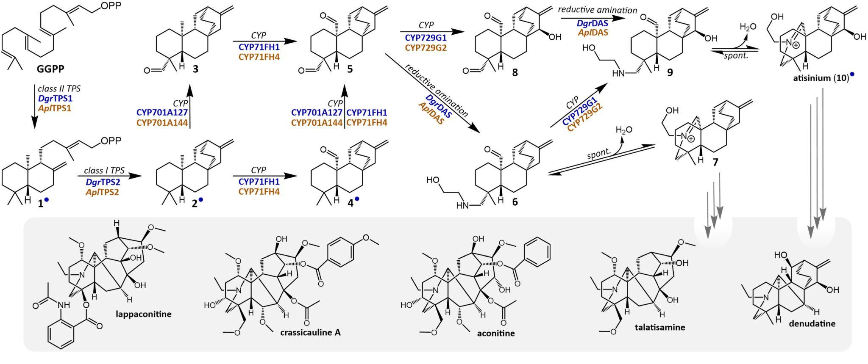
Study characterizes entry steps in diterpenoid alkaloid biosynthesis
Background/Objective
Diterpenoid alkaloids are a group of specialized metabolites found primarily within the Aconitum (wolfsbane) and Delphinium (larkspur) genera. Despite interest in these compounds for a wide range of bioactivities, their structural complexity poses significant challenges for chemical synthesis, making biosynthesis an appealing alternative. However, little progress has been made towards elucidation of their biosynthetic pathways.
Approach
Researchers performed transcriptome sequencing on Delphinium grandiflorum, Aconitum plicatum, and A. lycoctonum and incorporated public data from four other Aconitum species, allowing for comparative transcriptomics across tissue types and genera.
Proposed biosynthetic pathway towards diterpenoid alkaloids
Results
Transcriptomics analysis identified six enzymatic steps in the biosynthesis of atisinium, conserved across D. grandiflorum and A. plicatum. Coexpression analysis of A. vilmorinianum root tissue identified a novel reductase which has little homology to previously characterized enzymes. This reductase catalyzes a key step in the pathway, supporting formation of atisinium, a bioactive diterpenoid alkaloid and potential intermediate in the biosynthesis of more complex products. Isotope labeling in Acotinum callus cultures and computational metabolomics revealed that ethanolamine is the preferred source of nitrogen, despite the abundance of diterpenoid alkaloids with ethylamine groups attached to their central terpene scaffolds. Identification of these steps allowed for de novo biosynthesis of atisinium.
Significance/Impacts
Diterpenoid alkaloids have a wide range of applications, from natural pesticide to treatments for cancer, malaria, inflammation, and pain. This work will serve as the basis for further pathway discovery towards more complex diterpenoid alkaloid natural products and their biosynthetic production in heterologous hosts.
Miller, G. P., Mutabdžija-Nedelcheva, L., et al., Characterization of the Entry Steps in Diterpenoid Alkaloid Biosynthesis. Molecular Plant. (2026). [DOI:10.1016/j.molp.2026.05.022]

