Slide 1

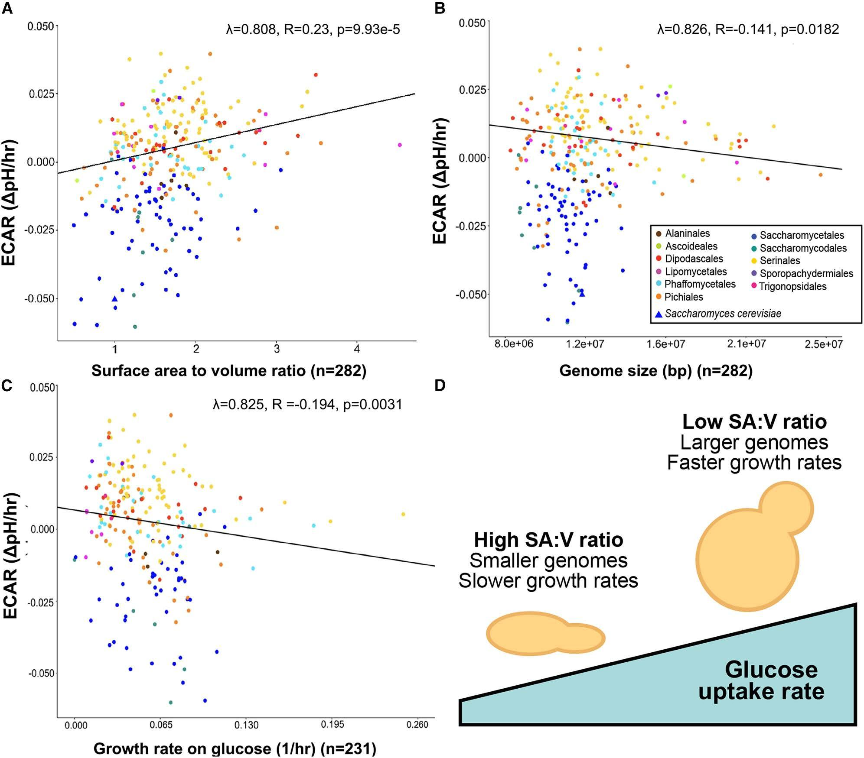
Trait syndrome links cell structure to metabolic efficiency across yeast subphylum
Background/Objective
Studies of the Saccharomycotina yeast subphylum have revealed that certain traits are consistently associated and may collectively contribute to trait syndromes driven by intrinsic factors such as genomic characteristics or extrinsic factors such as resource availability. A recent paper by Li et al. reported an inverse correlation between glucose uptake rates (GURs) and cell surface area-to-volume (SA:V) ratios across 11 yeast species.
Approach
Here researchers analyzed a dataset of glucose-induced extracellular acidification rates (ECARs) — as a proxy for glycolytic rates — and phenotypic variation across 282 species with Saccharomycotina to test whether the correlation holds true across an entire subphylum while controlling for phylogenetic covariance and considering two additional traits: genome size and growth rates on glucose.
Results
Using phylogenetic regression models, researchers found ECARs were weakly but significantly correlated with SA:V across Saccharomycotina and also correlated with genome size and growth rates. These findings support the reported correlation between GURs and SA:V ratios but suggest other associated traits including genome size contribute to variation in glycolytic rate. Specifically, yeasts that consume glucose faster tend to have lower SA:V ratios, faster growth rates, and larger genomes, suggesting a complex trait syndrome governing metabolic, genomic, and morphological traits across the subphylum.
Glycolytic rate significantly associated with cell morphology, genome size, and growth. Lower (negative) ECAR indicates faster glucose uptake.
Significance/Impacts
Data show that yeasts with larger genomes have faster metabolic and growth rates on glucose, suggesting those species could be promising for industrial applications, such as biofuel production, that require rapid metabolism. Further, these identified correlations can guide predictions of metabolic capabilities and guide future experiments to uncover mechanisms that link primary carbon metabolism to cell morphology.
Horianopoulos, L. C., Chavez, C. M., Rokas, A., & Hittinger, C. T. A trait syndrome ties cell morphology to glycolysis across the yeast subphylum. iScience, 29, 116395. (2026). [DOI:10.1016/j.isci.2026.116395]

