Slide 1

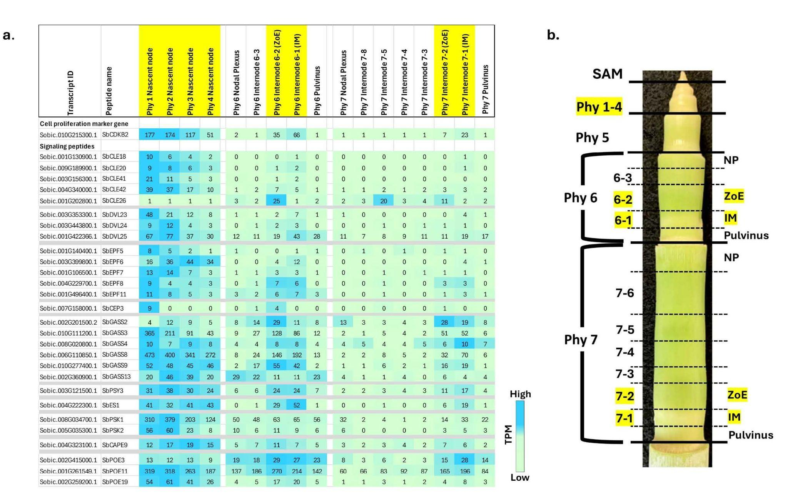
Small signaling peptides play distinct roles in sorghum stem development
Background/Objective
Small signaling peptides regulate plant growth, development, and stress responses, yet their role in the C4 grass Sorghum bicolor is largely unexplored. This study sought to identify sorghum genes that encode small signaling peptides and analyze the expression of these genes in organs, stem cell types, and during stem growth and development.
Approach
Researchers used published peptide sequences from other species to identify sorghum genes that may encode peptides and used phylogenetics and transcriptomics to analyze evolutionary relationships and expression patterns across tissue types and developmental stages.
Results
Analysis identified 219 signaling peptide-encoding genes assigned to 19 gene families. Expression in sorghum organs, during stem development, and in stem tissues and cell types revealed distinct spatial, temporal, and developmental patterns of expression. Cell type specific expression of genes was observed in fully elongated internodes, indicating high spatial resolution of gene regulation.
Expression of genes encoding small signaling peptides 824 that are highly expressed in sorghum stem growing zones.
Significance/Impacts
Sorghum’s high productivity, low carbon intensity, low input requirements, and drought resilience make it a promising crop for bioenergy production. These results provide a foundation of information for analysis of peptide signaling functions that can be integrated with knowledge of gene regulatory networks to modulate key traits for sorghum crop production. Further characterization could provide strategies to increase biomass yields through targeted genetic or agronomic interventions.
Kurtz, E., McKinley, B., & Mullet, J. Small Signaling Peptides in Sorghum bicolor: Integrating Phylogeny and Gene Expression to Characterize Roles in Stem Development. Plant Direct, 10, e70177. (2026). [DOI:10.1002/pld3.70177]

