Slide 1

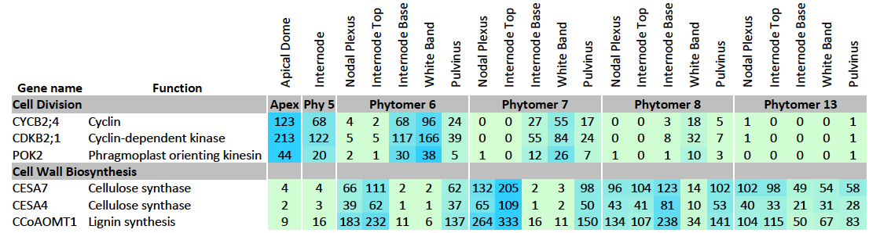
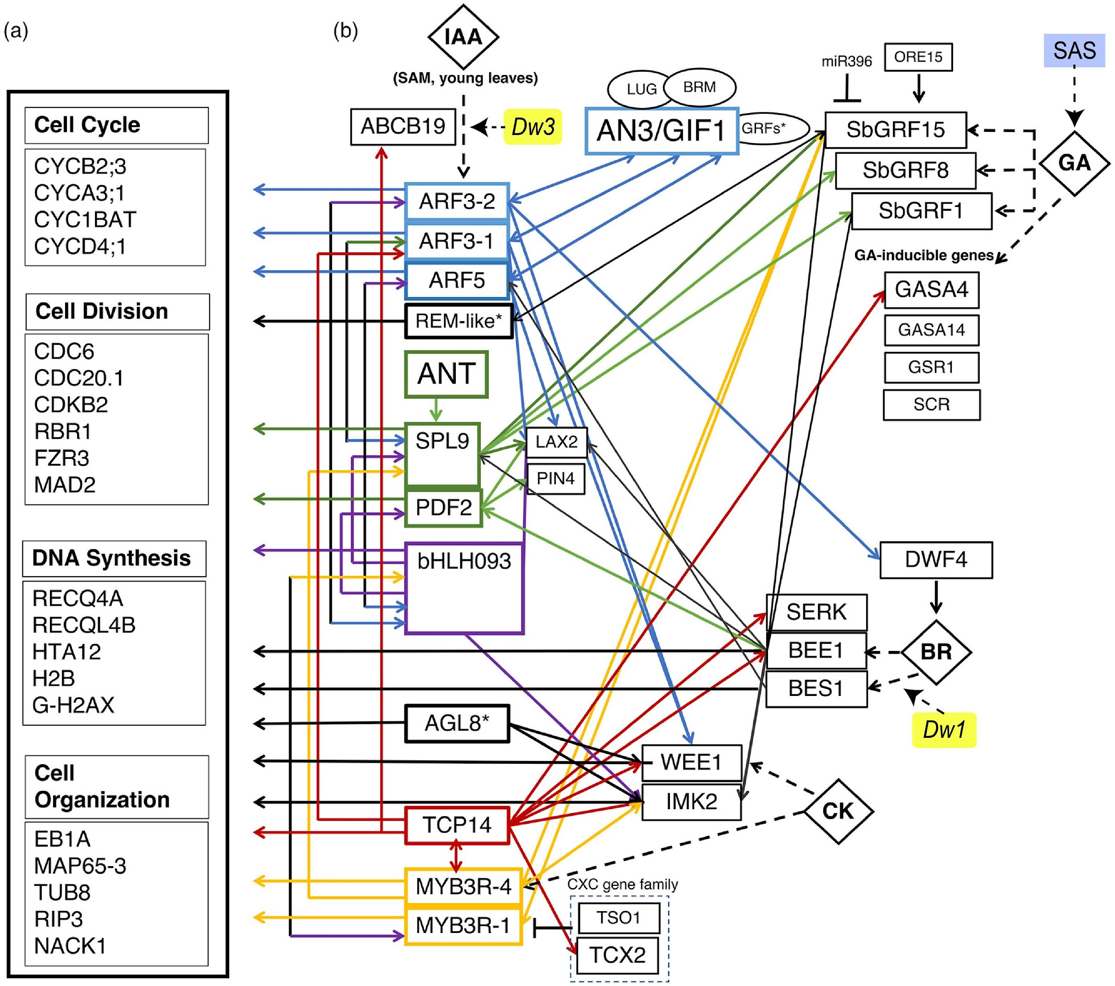
A sorghum transcriptome compendium is helping decipher the sorghum genome’s regulatory code
Background/Objective
Sorghum bicolor (sorghum) is a drought and heat tolerant C4 grass used for production of grain, forage, and biofuels. Crop breeders have improved sorghum crops through phenotypic and DNA-marker-based selection of beneficial traits present in diverse germplasm. Generation of sorghum genome sequences and transcriptome informed gene regulatory networks can now aid crop improvement through gene editing mediated pathway/trait engineering.
Expression heat map example of genes differentially expressed in the intercalary meristem during stem development.
Approach
GLBRC researchers, in collaboration with the Joint Genome Institute, collected RNA-seq profiles from sorghum organs, tissues, cell types, developmental stages, and responses to diverse treatments and environmental conditions (diel, day-length, shading, water deficit, nitrogen, temperature) as part of more than 20 studies conducted between 2018 and 2025 reported in 17 publications. Transcriptome analyses enabled construction of gene regulatory networks and enhanced our understanding of sorghum wax accumulation, dhurrin biosynthesis, raffinose oligosaccharide synthesis, and root system development and function, as well as the regulation of genes that modulate stem growth, secondary cell wall synthesis, and increases in stem density during adult vegetative growth and stem sucrose and starch accumulation post floral initiation.
Model of hormone signaling in the sorghum intercalary meristem gene regulatory network with transcription factors upstream of the genes related to cell proliferation.
Results
Researchers constructed a compendium of more than 1,000 sorghum transcriptome profiles from 15 genotypes grown in a wide range of environments and treatments. Data from ~1,000 additional RNA-seq profiles will be added following a short embargo to ensure quality control. This study describes compendium content and how the compendium has been used to identify sorghum genes/pathways that modulate sorghum growth, development, and resilience. Artificial intelligence and machine-learning-aided analysis of compendium data can guide gene regulatory network analyses, gene editing and pathway/trait engineering.
Cell Proliferation
Significance/Impacts
This transcriptome compendium will help scientists decipher the sorghum genome’s regulatory code and identify gene editing targets that improve yield, resilience, and composition.
Glenn, P. D., et al. Compilation and utilization of a sorghum transcriptome compendium for gene regulatory network analysis and crop trait engineering. The Plant Journal, 126, e70922. (2026). [DOI:10.1111/tpj.70922]

