Slide 1
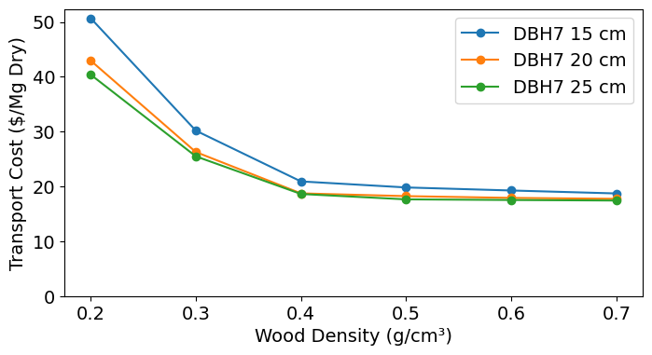
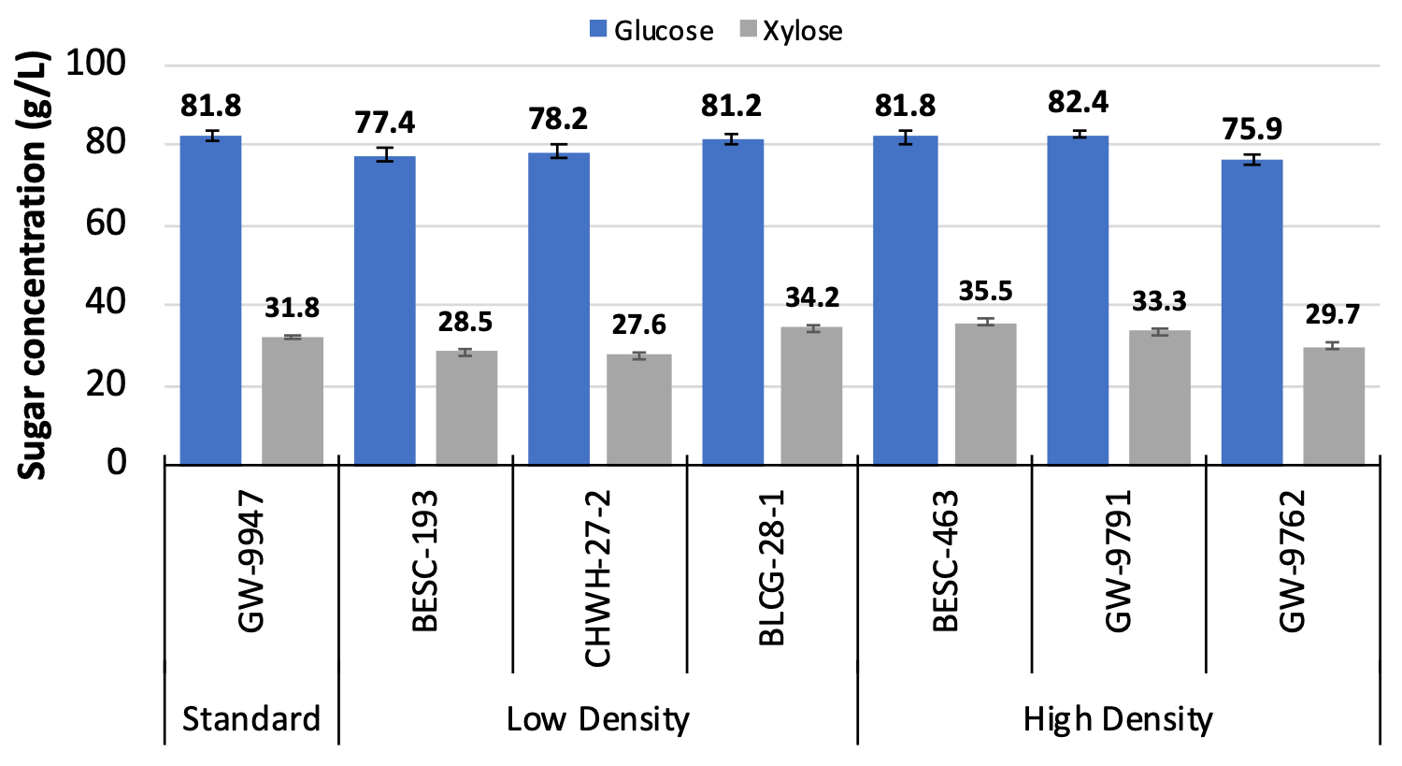
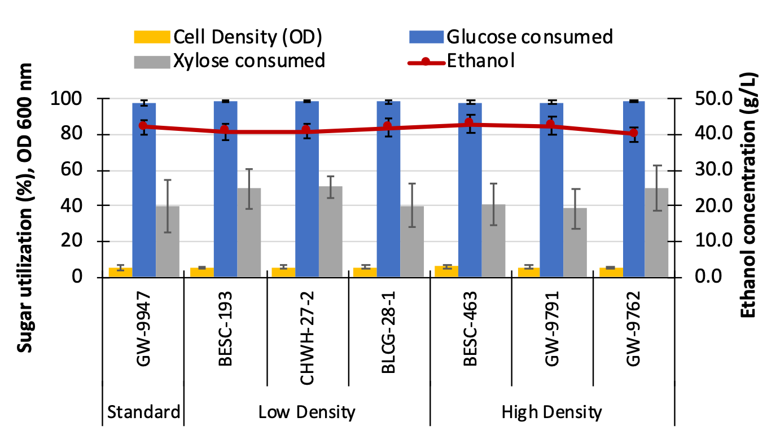



Higher Wood Density Lowers Feedstock Cost and Has Minimal Impact on Biomass Conversion to Biofuels
Background/Objective
Wood density is an underexplored yet important trait of biomass crops that can be leveraged to improve transportation cost and overall economics. While wood density is known to vary among species, the extent of variation within a species or population is less understood.
Approach
A population of Populus trichocarpa genotypes was used to quantify variation in wood density.
Phenotypic and genomic analyses were used to assess correlations between density and growth and composition and estimate genetic control.
Techno-economic modeling was used to evaluate how variation in wood density impacted biomass production and transportation costs.
A subset of genotypes were processed using two bioconversion pipelines to assess impacts of wood density on conversion.
Effect of biomass density on transportation cost
Results
There was significant variation in wood density with only weak negative correlations with growth traits, indicating poplar can be improved for yield and density with minimal trade-offs.
Increasing wood density significantly reduced transportation costs up to ~20% due to higher mass per unit volume and improved logistics efficiency.
Wood density was not correlated with biomass composition or recalcitrance, and experimental validation showed no significant differences in sugar release, fermentation efficiency, or biofuel yield between high- and low-density genotypes.
Significance/Impacts
Increasing wood density can improve the economics of biomass crops without impacting productivity or composition and can enhance supply chain efficiency without negatively affecting biomass conversion.
Effect of density on sugar yields upon deconstruction using aqueous ammonia (top) and fermentation to ethanol (bottom)
Ployet, R. et al. ACS Sustainable Chem. Eng. (2026) 14, 6277–6290, doi:10.1021/acssuschemeng.5c10590

